Slide 1
The Blockchain As I see It
@0xk2_
uk.superteam.fun

Slide 2
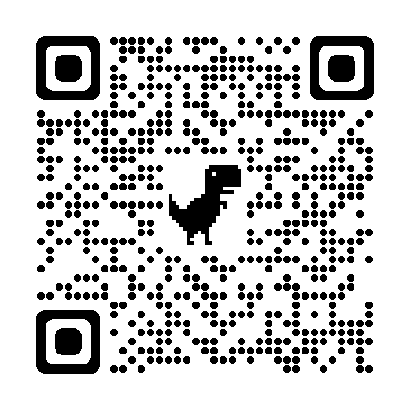
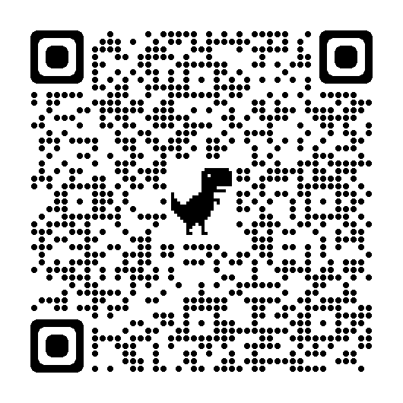
Index
Blockchain Basic Concept
Solana Development
What make Solana special?
DeFi Decrypt
DAO decrypt
NFT Decrypt (draft)
150+ pages slide, regular update
Join the group: https://t.me/solanawrkshp
Get the slide

Slide 3
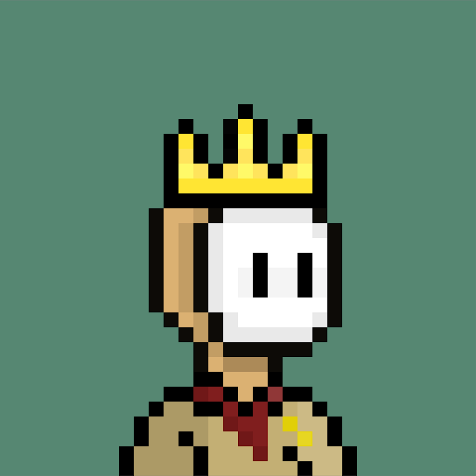

About me
Hieu, Serial entrepreneur & Software engineer
Found & Co-found: TerraBook (2012), Edumall (2015), Hectagon & SyncVote (2021)
Developer Relation @ Solana Superteam Vietnam & UK (2022 - 2024)
Country Lead @ Solana Superteam Vietnam
MSc @ Blockchain, QMUL
0xk2_

Slide 4

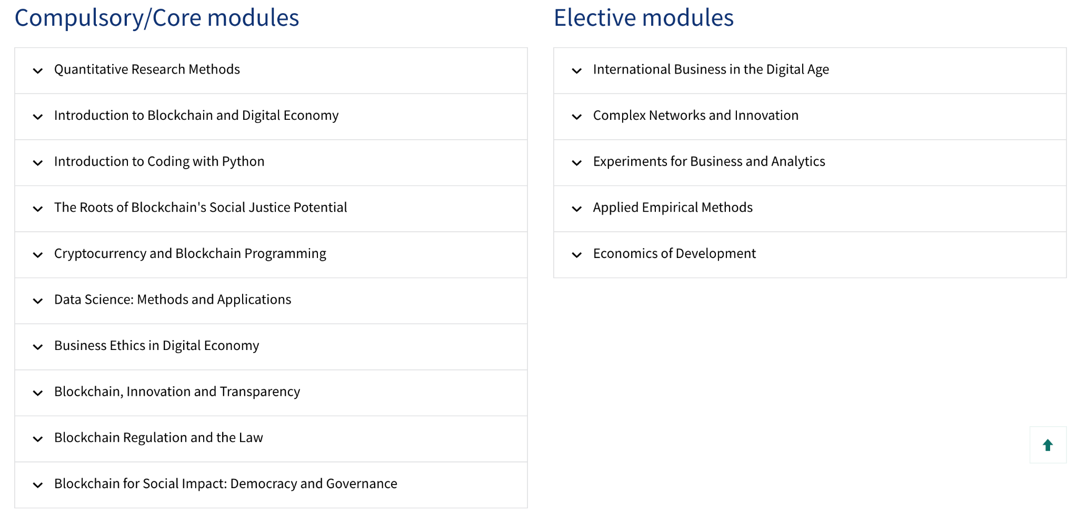
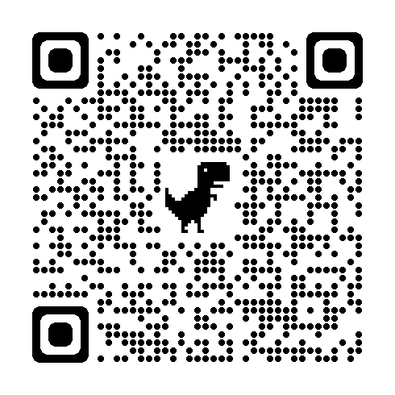
Blockchain in Business and Society MSc
https://shorturl.at/jkyEP

Slide 5
What is your expectation from this workshop?

Slide 6
Objective
What is blockchain, for real?
Understand blockchain “technically”
POV: software architecture
I want to build something
The BUIDLER map
How to get started?

Slide 8
Blockchain basic concept
Notes:
Question: what is blockchain?

Slide 9
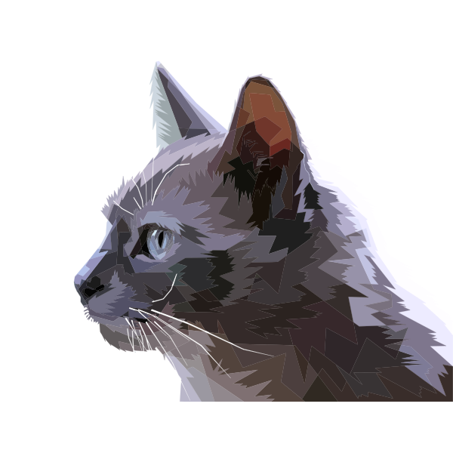
"Boss"
A cat
A Felis Catus
"The label you assign to something reflect your relationship to it"

Slide 10
To an engineer: Blockchain is a Decentralized Super-Computer
OR
Special-Purpose Cloud Computing Platform

Slide 11
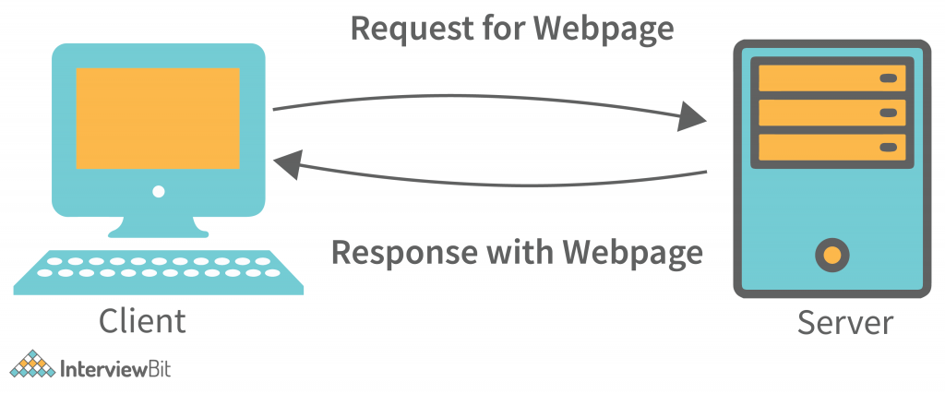
The Internet as we know: Client-Server model

Slide 12
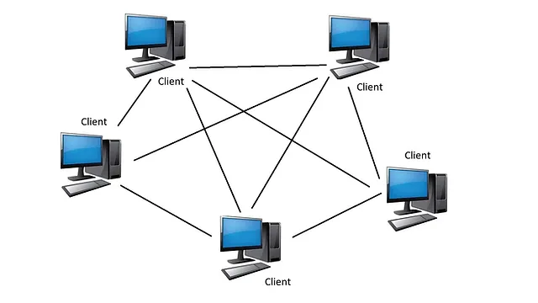
How the Peer to Peer works on the Internet?
How Bittorent works?

Slide 13

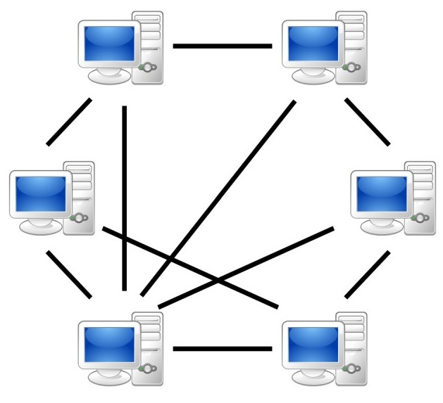

How blockchain works? (Physically) ”everything everywhere all at once”
Node
Node
Mainnet
Ethereum nodes
Solana Nodes
Layer 2
Node

Slide 14
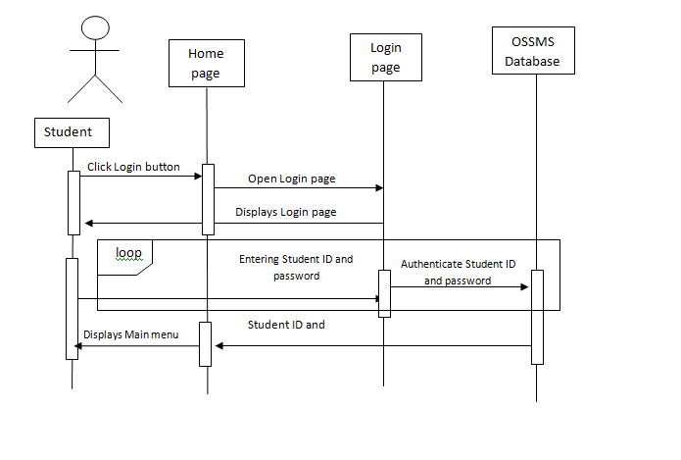
Sign Up & Login
Centralized of risk
Server has to store “password” or encrypted version of “password”
In real world, server store “token” to let user gain access to services
Cannot apply this model to public blockchain since every validators share information & everyone can be a validator

Slide 15
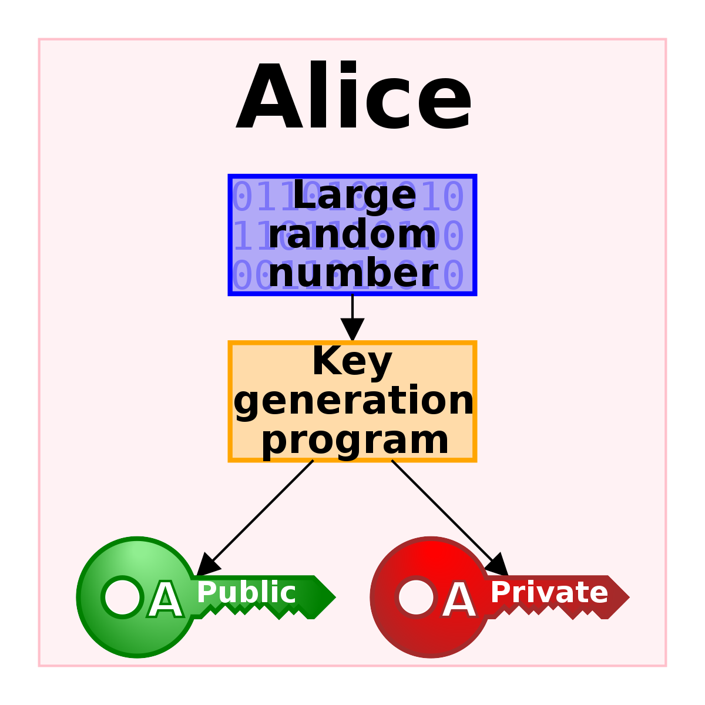
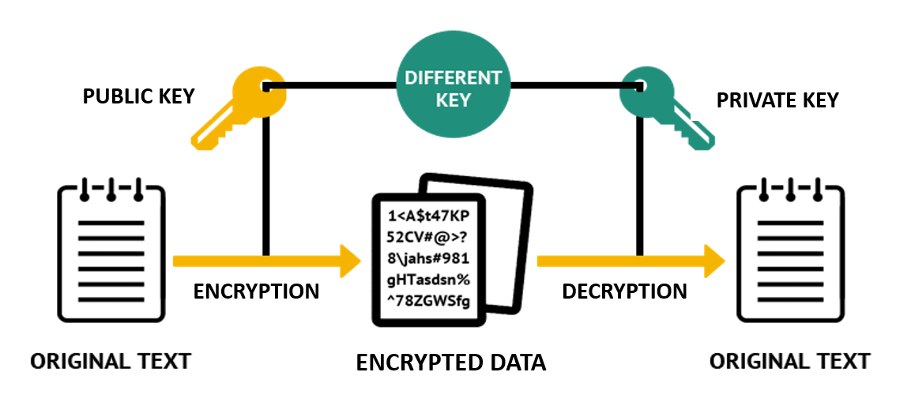
How validator works?_p1
Client generate a public & private key (without internet connection)
Private & Public key can work 2 ways:
Encrypt by Public Key, Decrypt by Private Key
Encrypt by Private Key, Decrypt by Public Key
Let’s see how lucky you are:
https://privatekeys.pw/keys/bitcoin/random

Slide 16
How validator works?_p2
raw_data == decrypt(public_key, hashed)
Client
{public_key, hashed, raw_data}
Validator
hashed = encrypt(private_key, raw_data)
RPC provider
You can prove your identity without exposing your secret or rely on a centralized third party

Slide 17
How validator works_p3

Slide 18
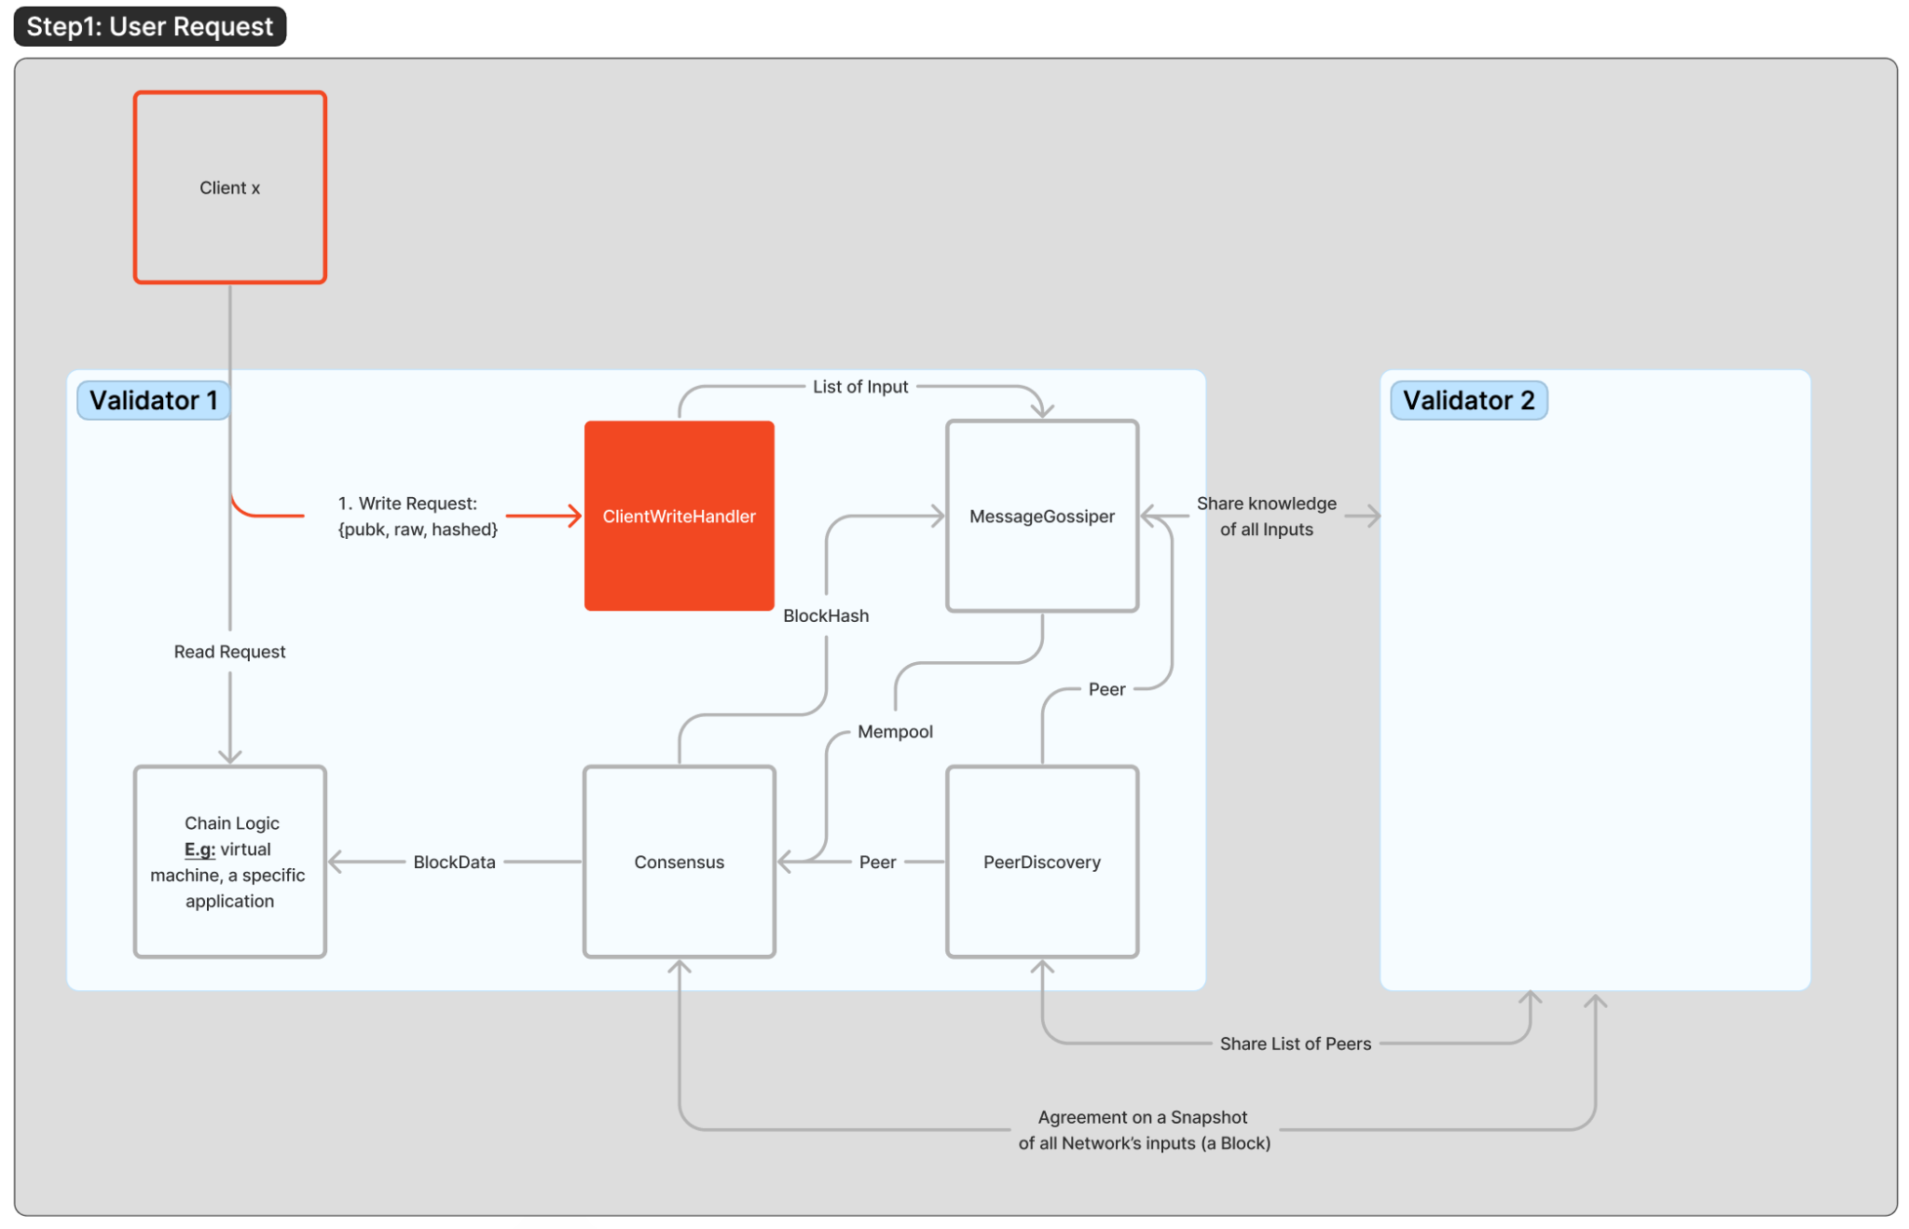

Slide 19
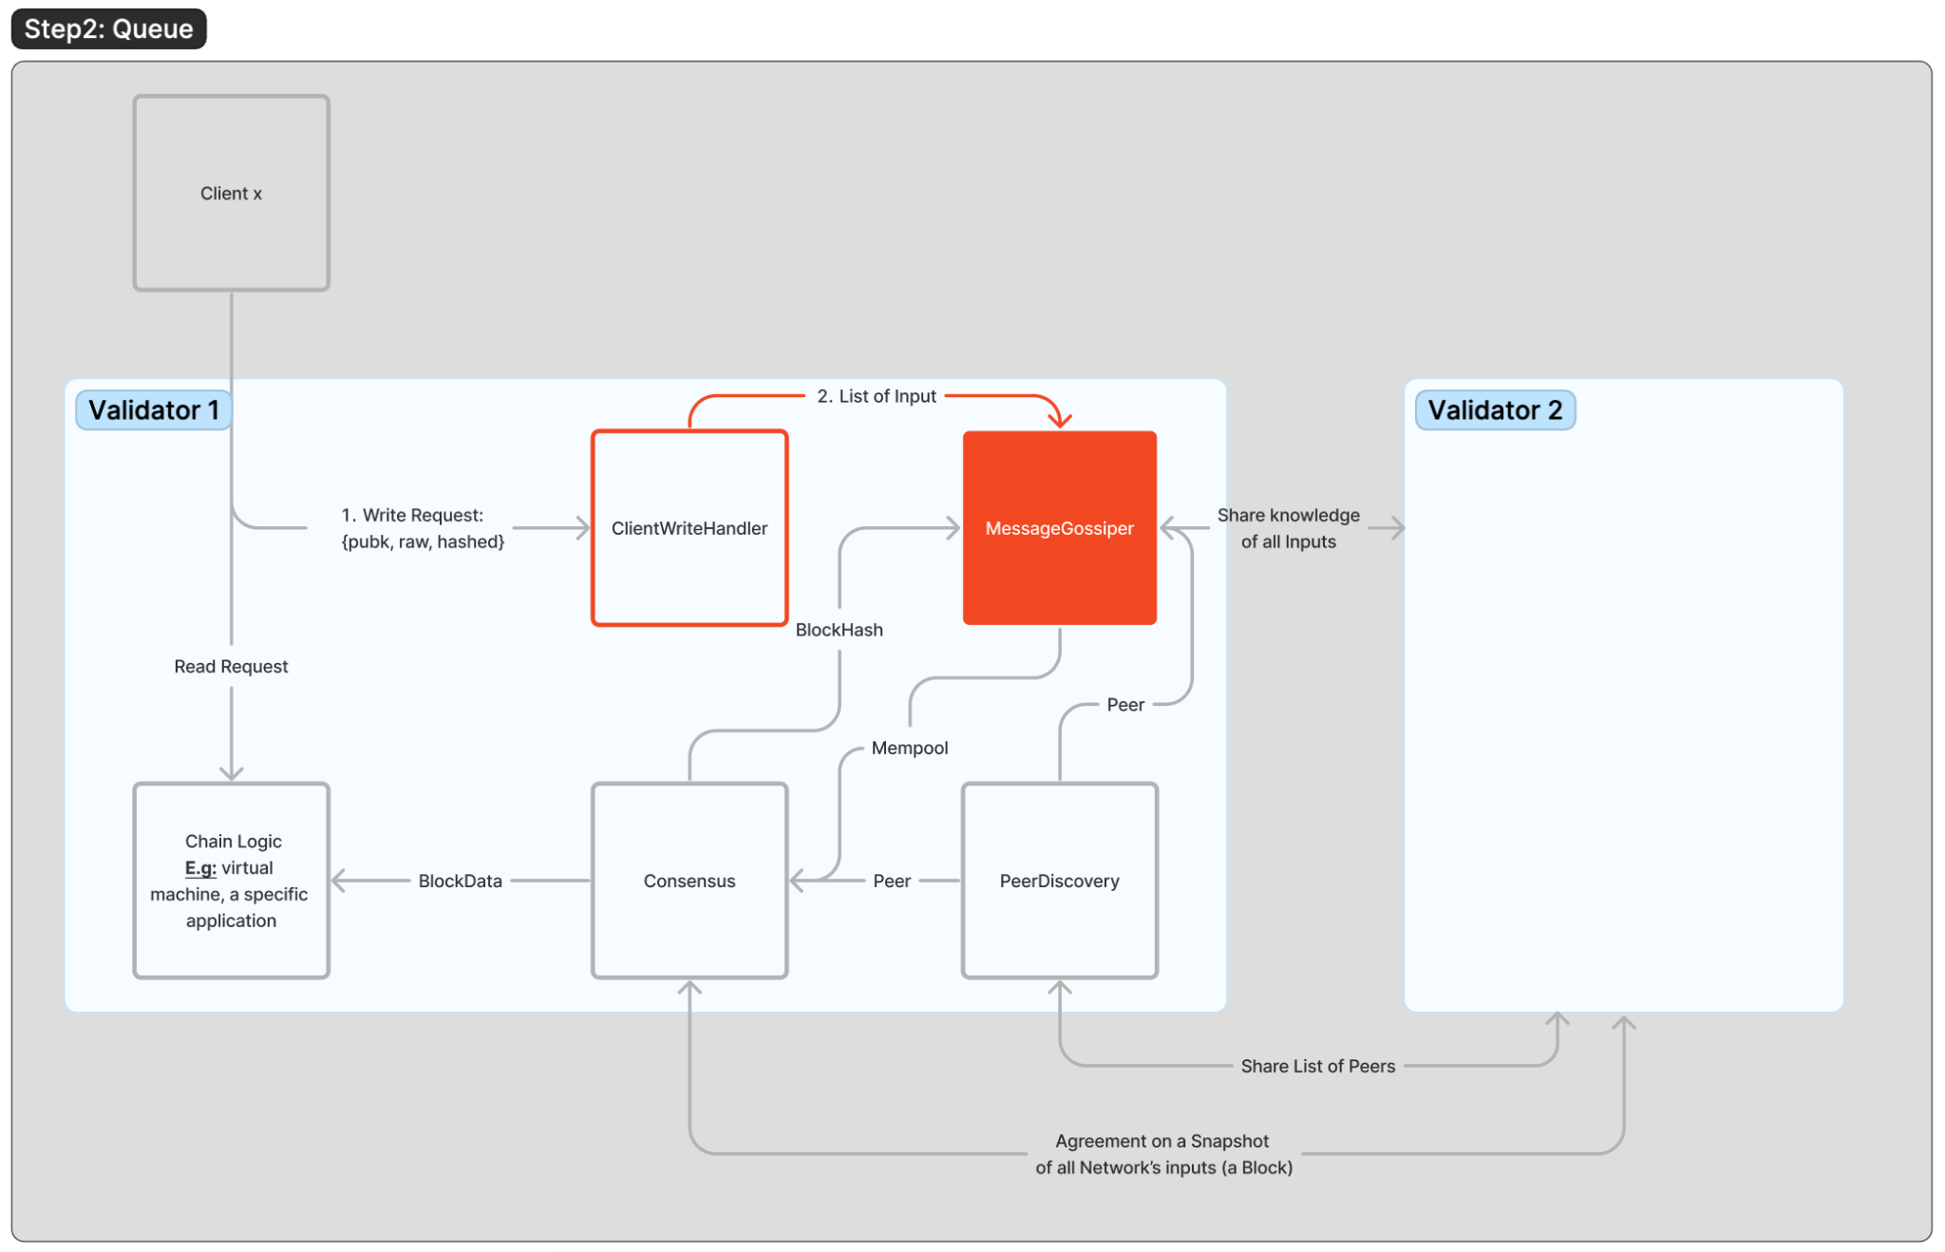

Slide 20
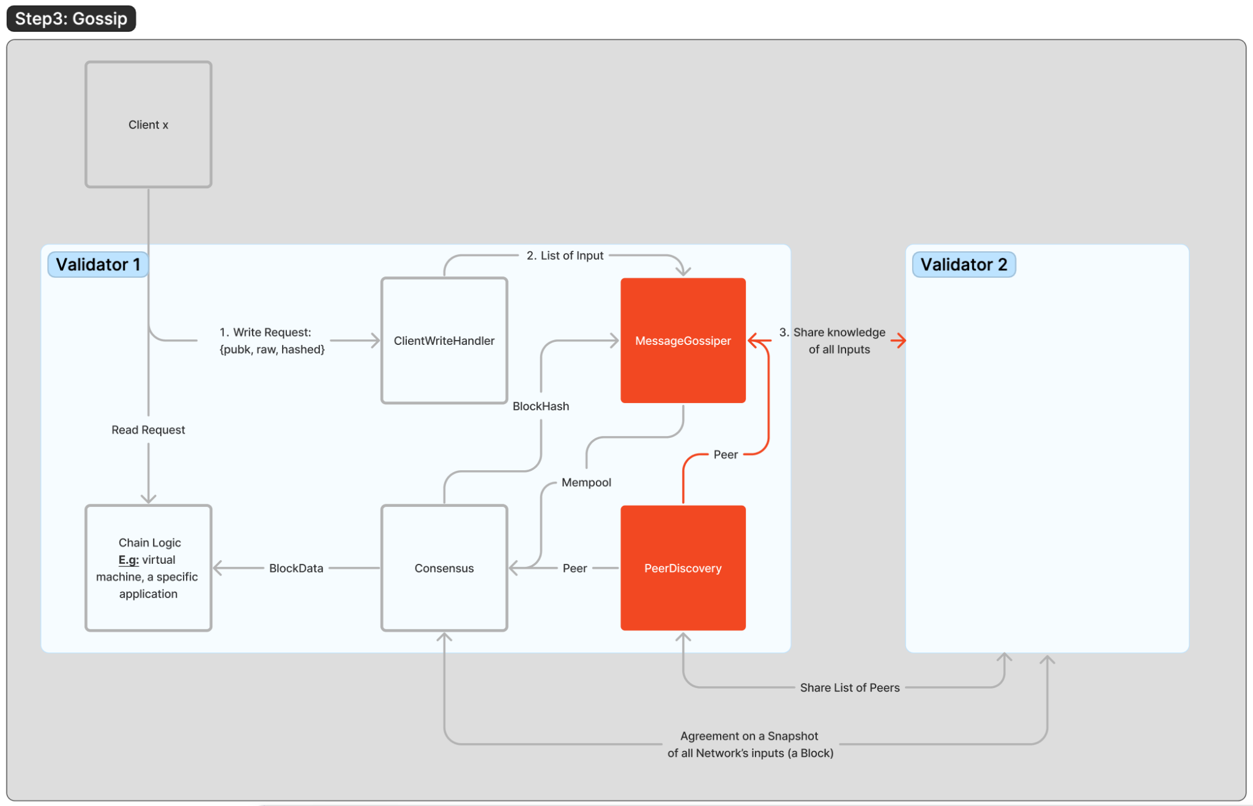

Slide 21
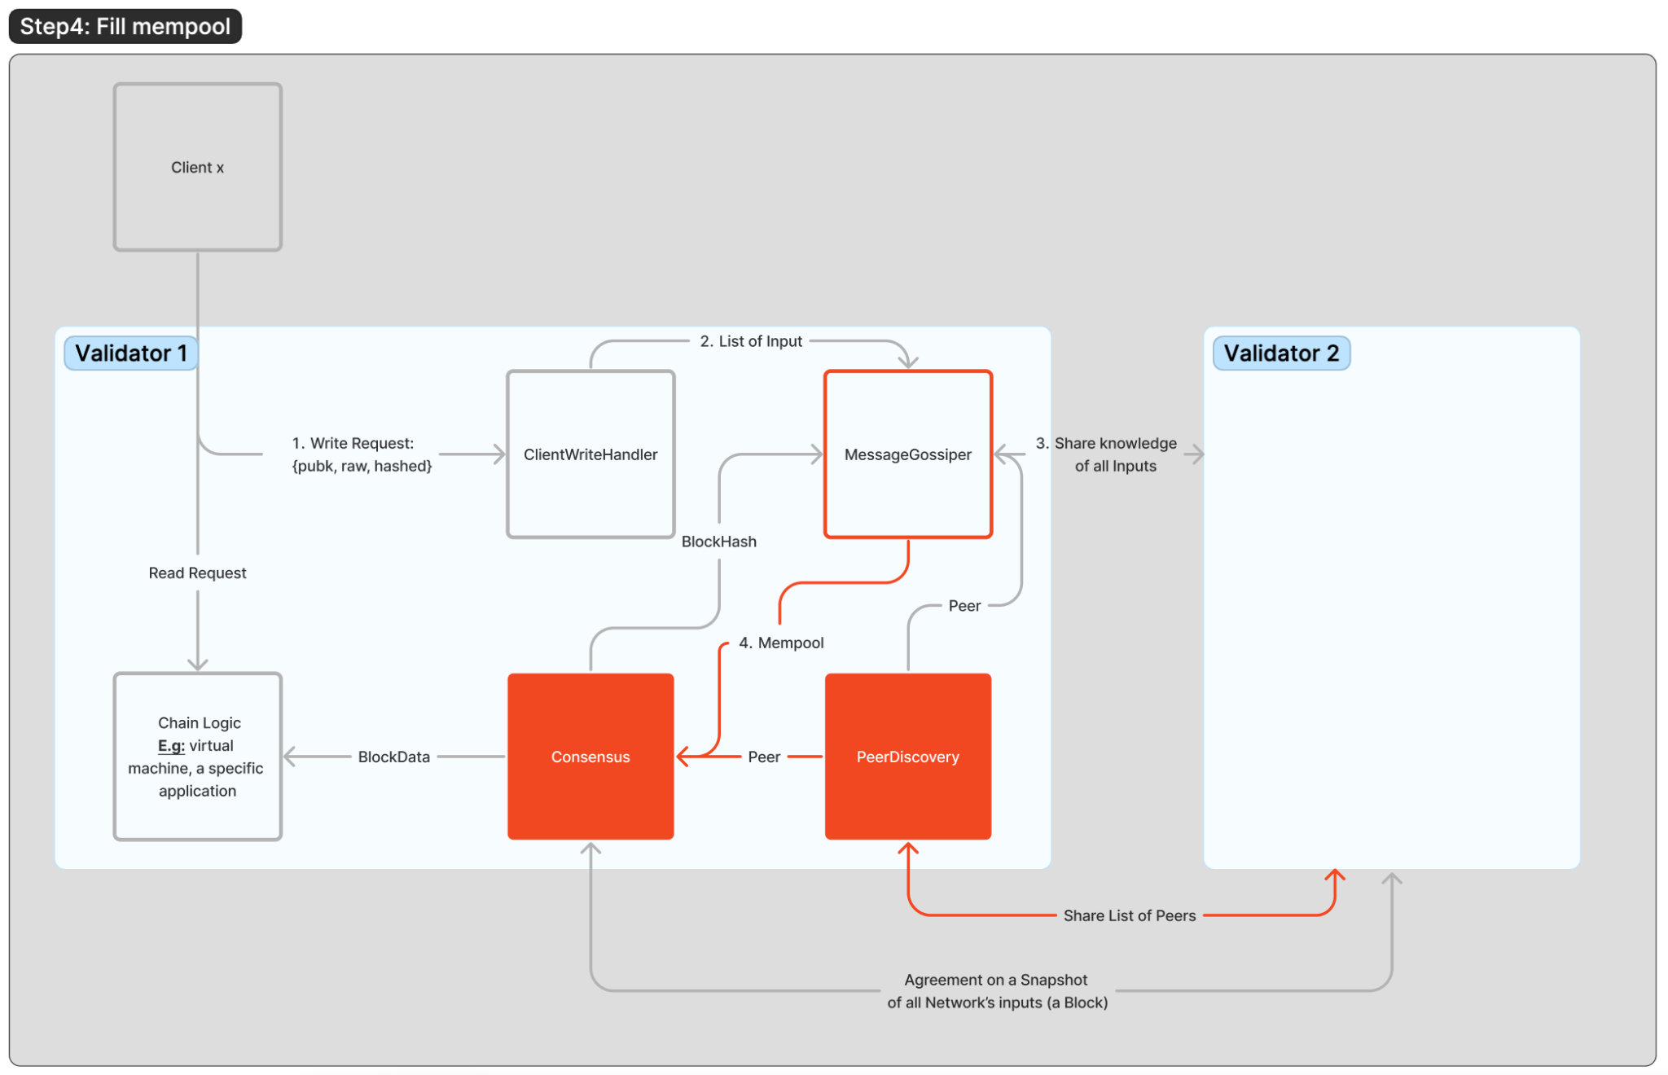

Slide 22
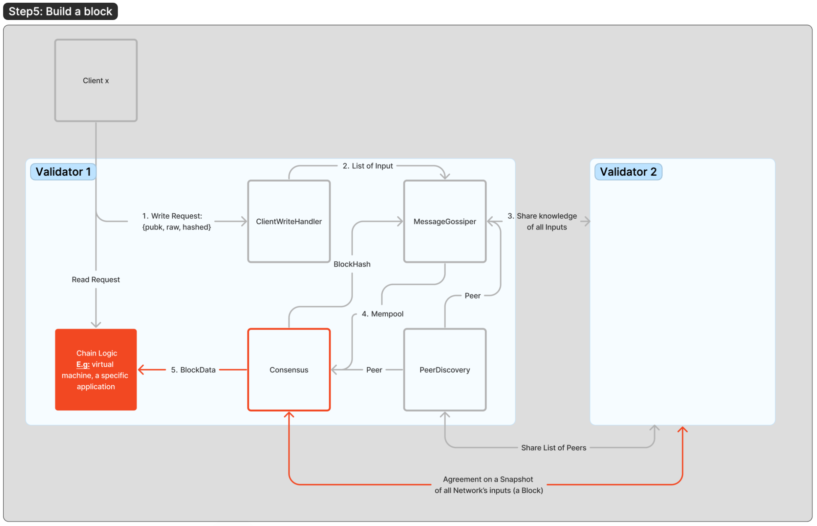

Slide 23
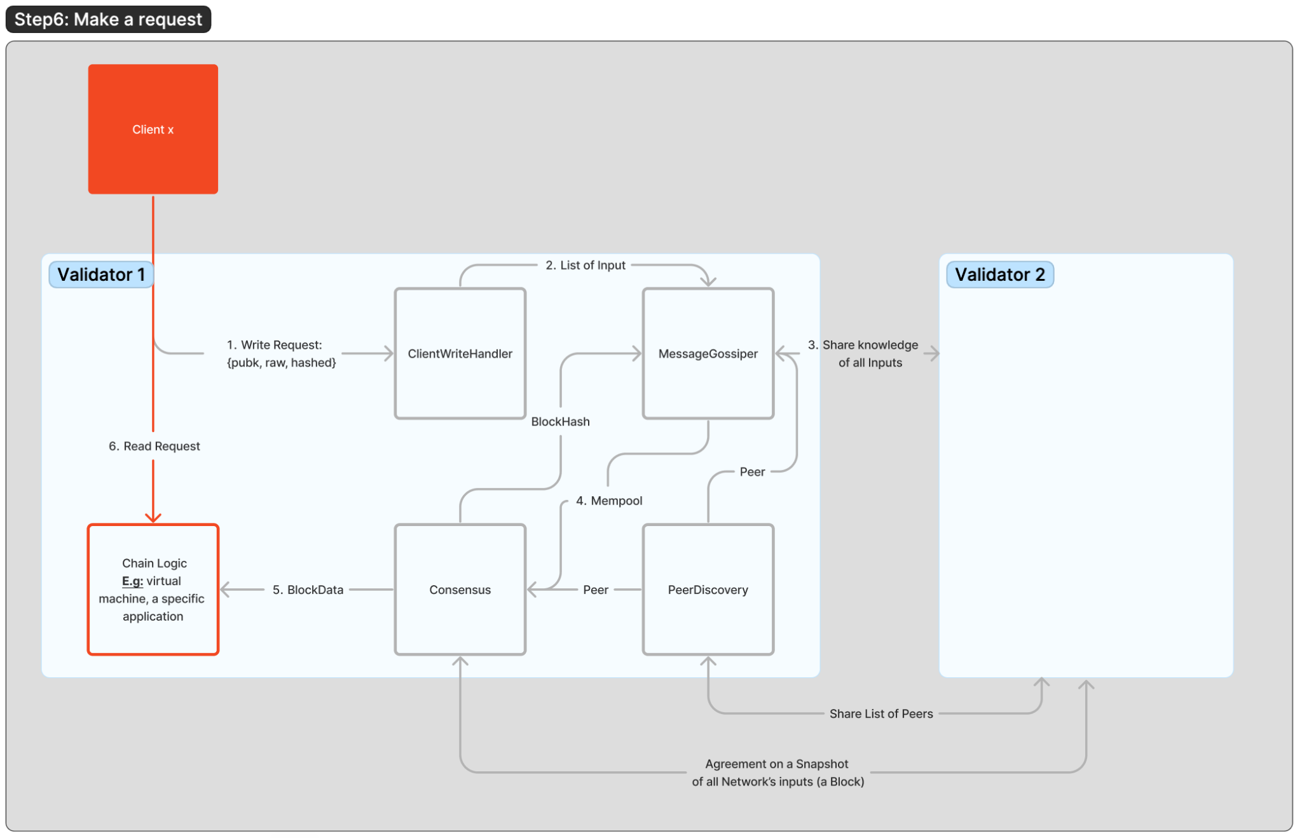

Slide 24
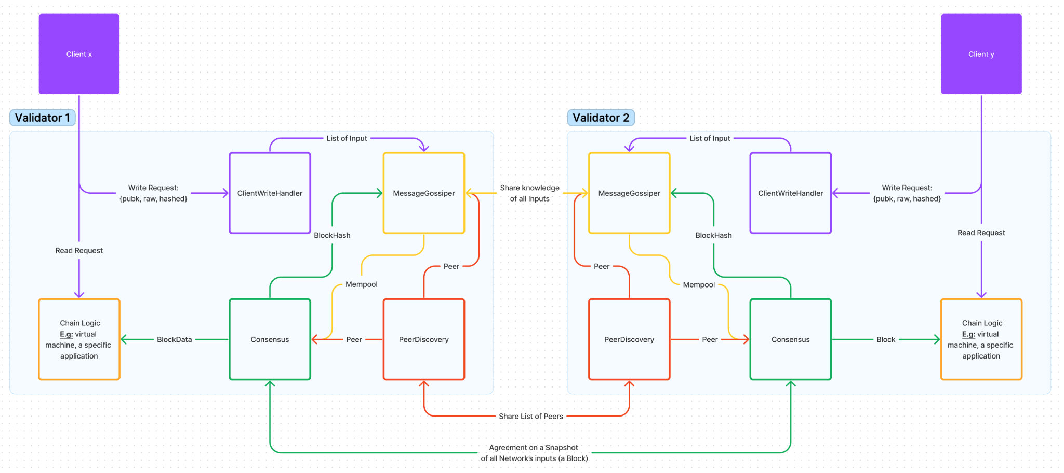
How validator works? (logically)
Layer 2

Slide 25
Observations
What blockchain reach consensus is the “input” of all the network, NOT the output, nor MEMORY
Not every node looks the same:
Not every node provide “READ & WRITE” service, once who does named “RPC” node
Some node only involve in consensus and DO NOT store information on few hundreds latest blocks -> “Light node”
…
If your blockchain have few thousand nodes but most users rely on very few RPC then your blockchain is not really “decentralized”
Notes:
Question: how sign up & login works?

Slide 26
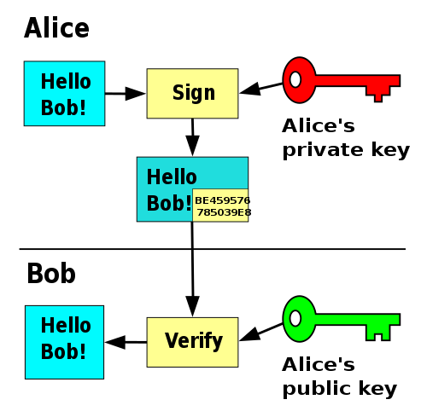
Authentication on Blockchain
Blockchain enable "censorship resistant" by implement "Private Key" - “Public Key” authentication model, instead of login & sign up (really?) When you create a key pair Private Key - Public Key in blockchain, it is AN OFF-CHAIN PROCESS
List of popular algorithm to generate Private & Public key pair
RSA in 15 minutes.
Notes:
Question: how sign up & login works?

Slide 27
How private key interact with Blockchain?
raw_data = decrypt(public_key, hashed)
Client
{public_key, hashed, raw_data}
Validator
hashed = encrypt(private_key, raw_data)
RPC provider
You can prove your identity without exposing your secret or rely on a centralized third party

Slide 28
How Blockchain works? (logically)
Operating System | Windows / MacOS / Linux | Solana / Ethereum
Type of processing | Computing process is centralized at a single computer. | Computing process is distributed in multiple computer (node validator); Result is summarized in every block through a consensus process with all nodes.
Application | .exe (windows), executable files (MacOS & Linux) | Program (Solana) / SmartContract (Ethereum)
Data | Data file, e.g: .png, .jpg, .doc, etc. | Account (Solana) / SmartContract (Ethereum)
Layer 2

Slide 29
Compare Blockchain vs Internet client-server model
 | Client-server model | Blockchain model
Computing & Storage | Single point of failure Efficient | Highly secured Inefficient
Ownership | Enterprise-owned | User-owned
Layer 2

Slide 30
So, you want to build?

Slide 31
Blockchain is just an Operating System

Slide 32
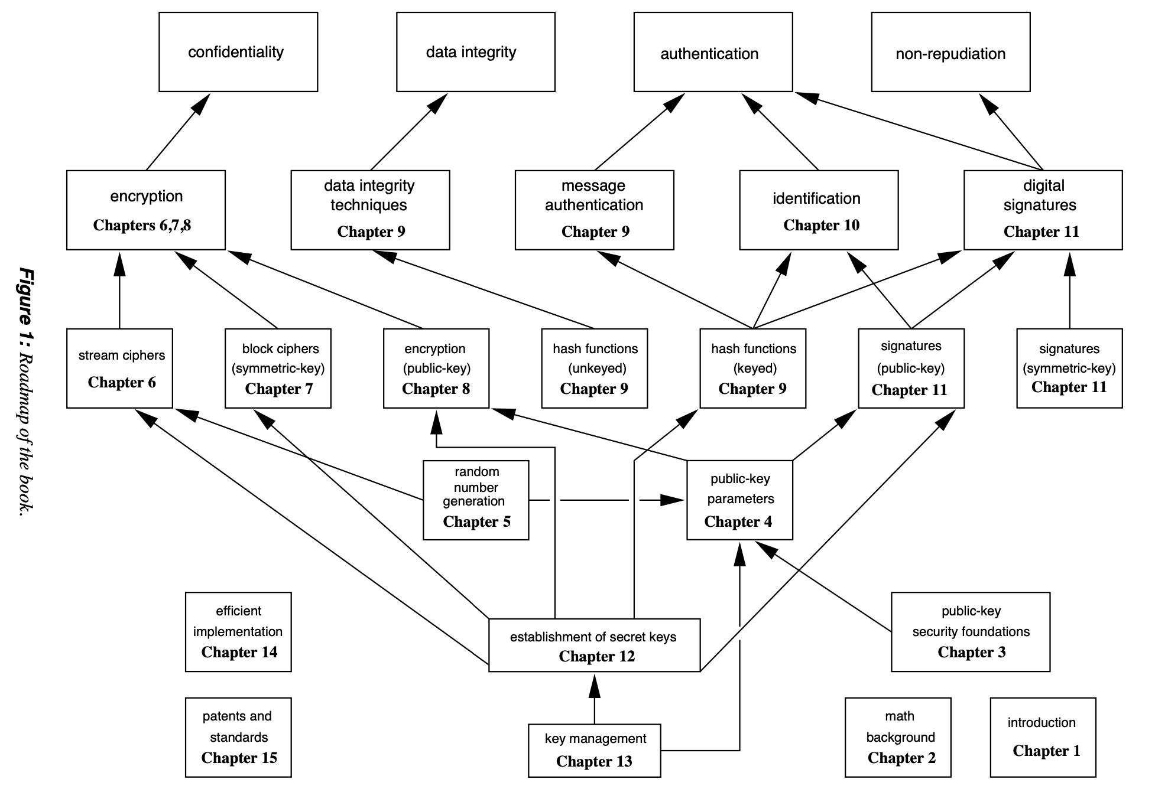
Blockchain vs Web2

Slide 33
That solve collaboration and cooperation
class of problems

Slide 34
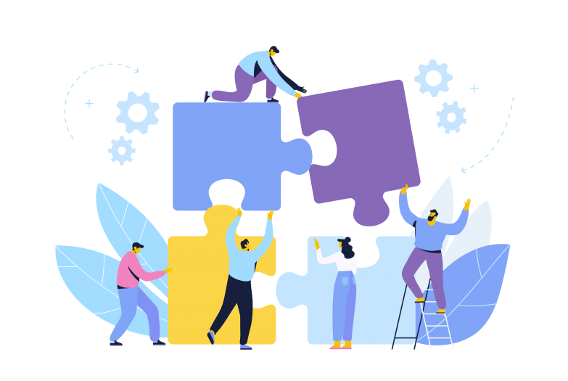
collaboration
Work together toward the same goal
Example:
Publish a book
Schedule an event
Produce a movie

Slide 35
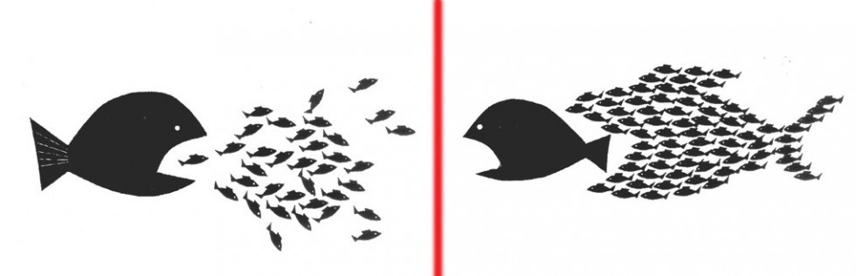
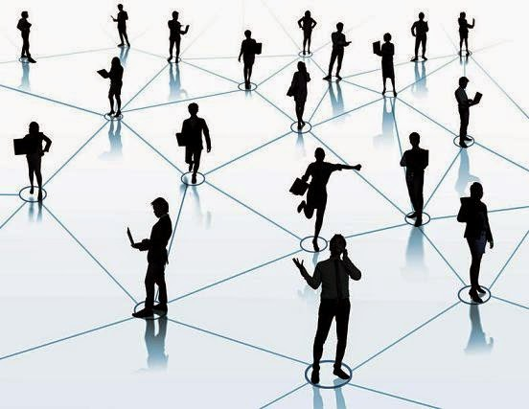
cooperation
Hard to separate from competition
Example:
Price discovery: trading, investment, etc.
Optimal way to share resources

Slide 36

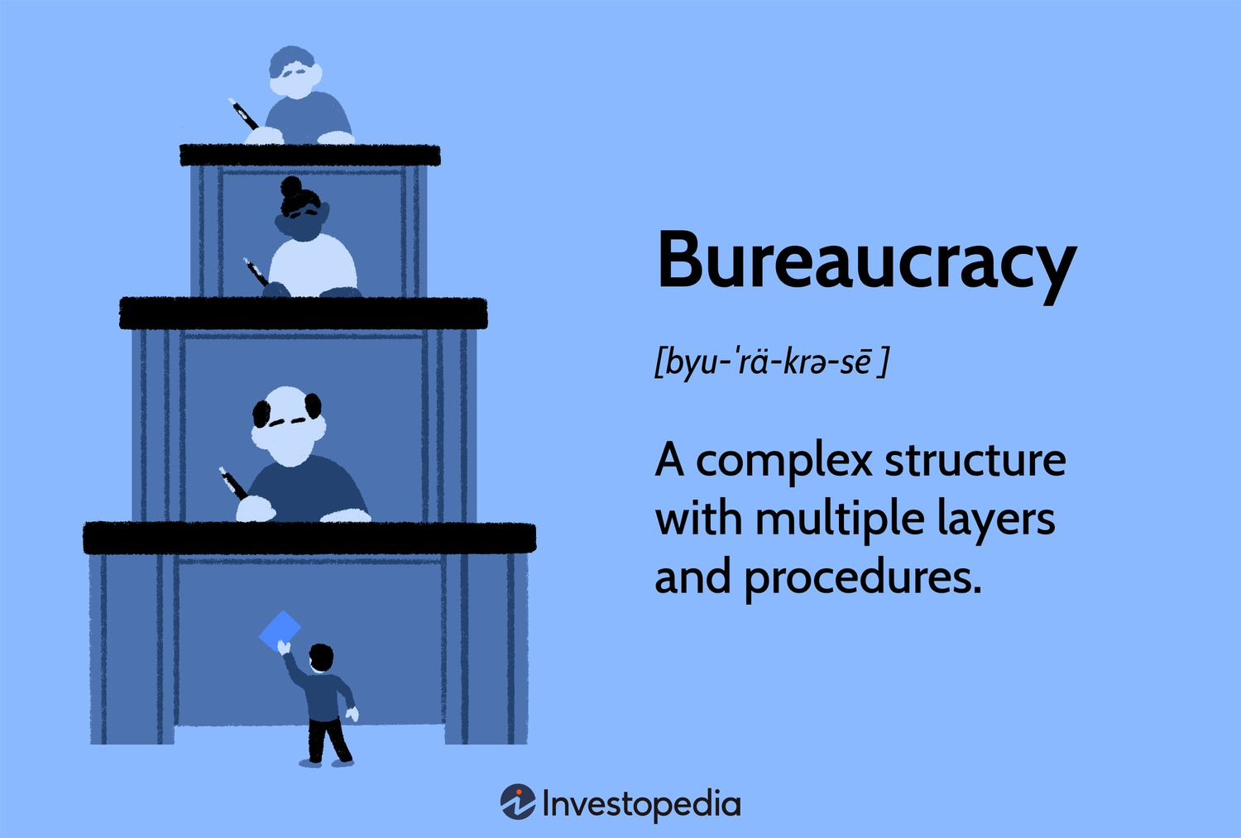
Example ~ problems

Slide 37


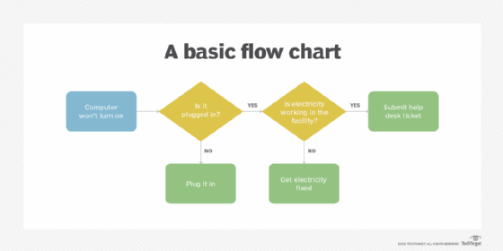
Example ~ solution
{Slot - blood type - expiration}
Transparency workflow

Slide 38
If you build a Game on Windows? What would you do?
Windows API (I don’t even know what it is) or Unity and the like?

Slide 39
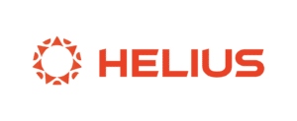
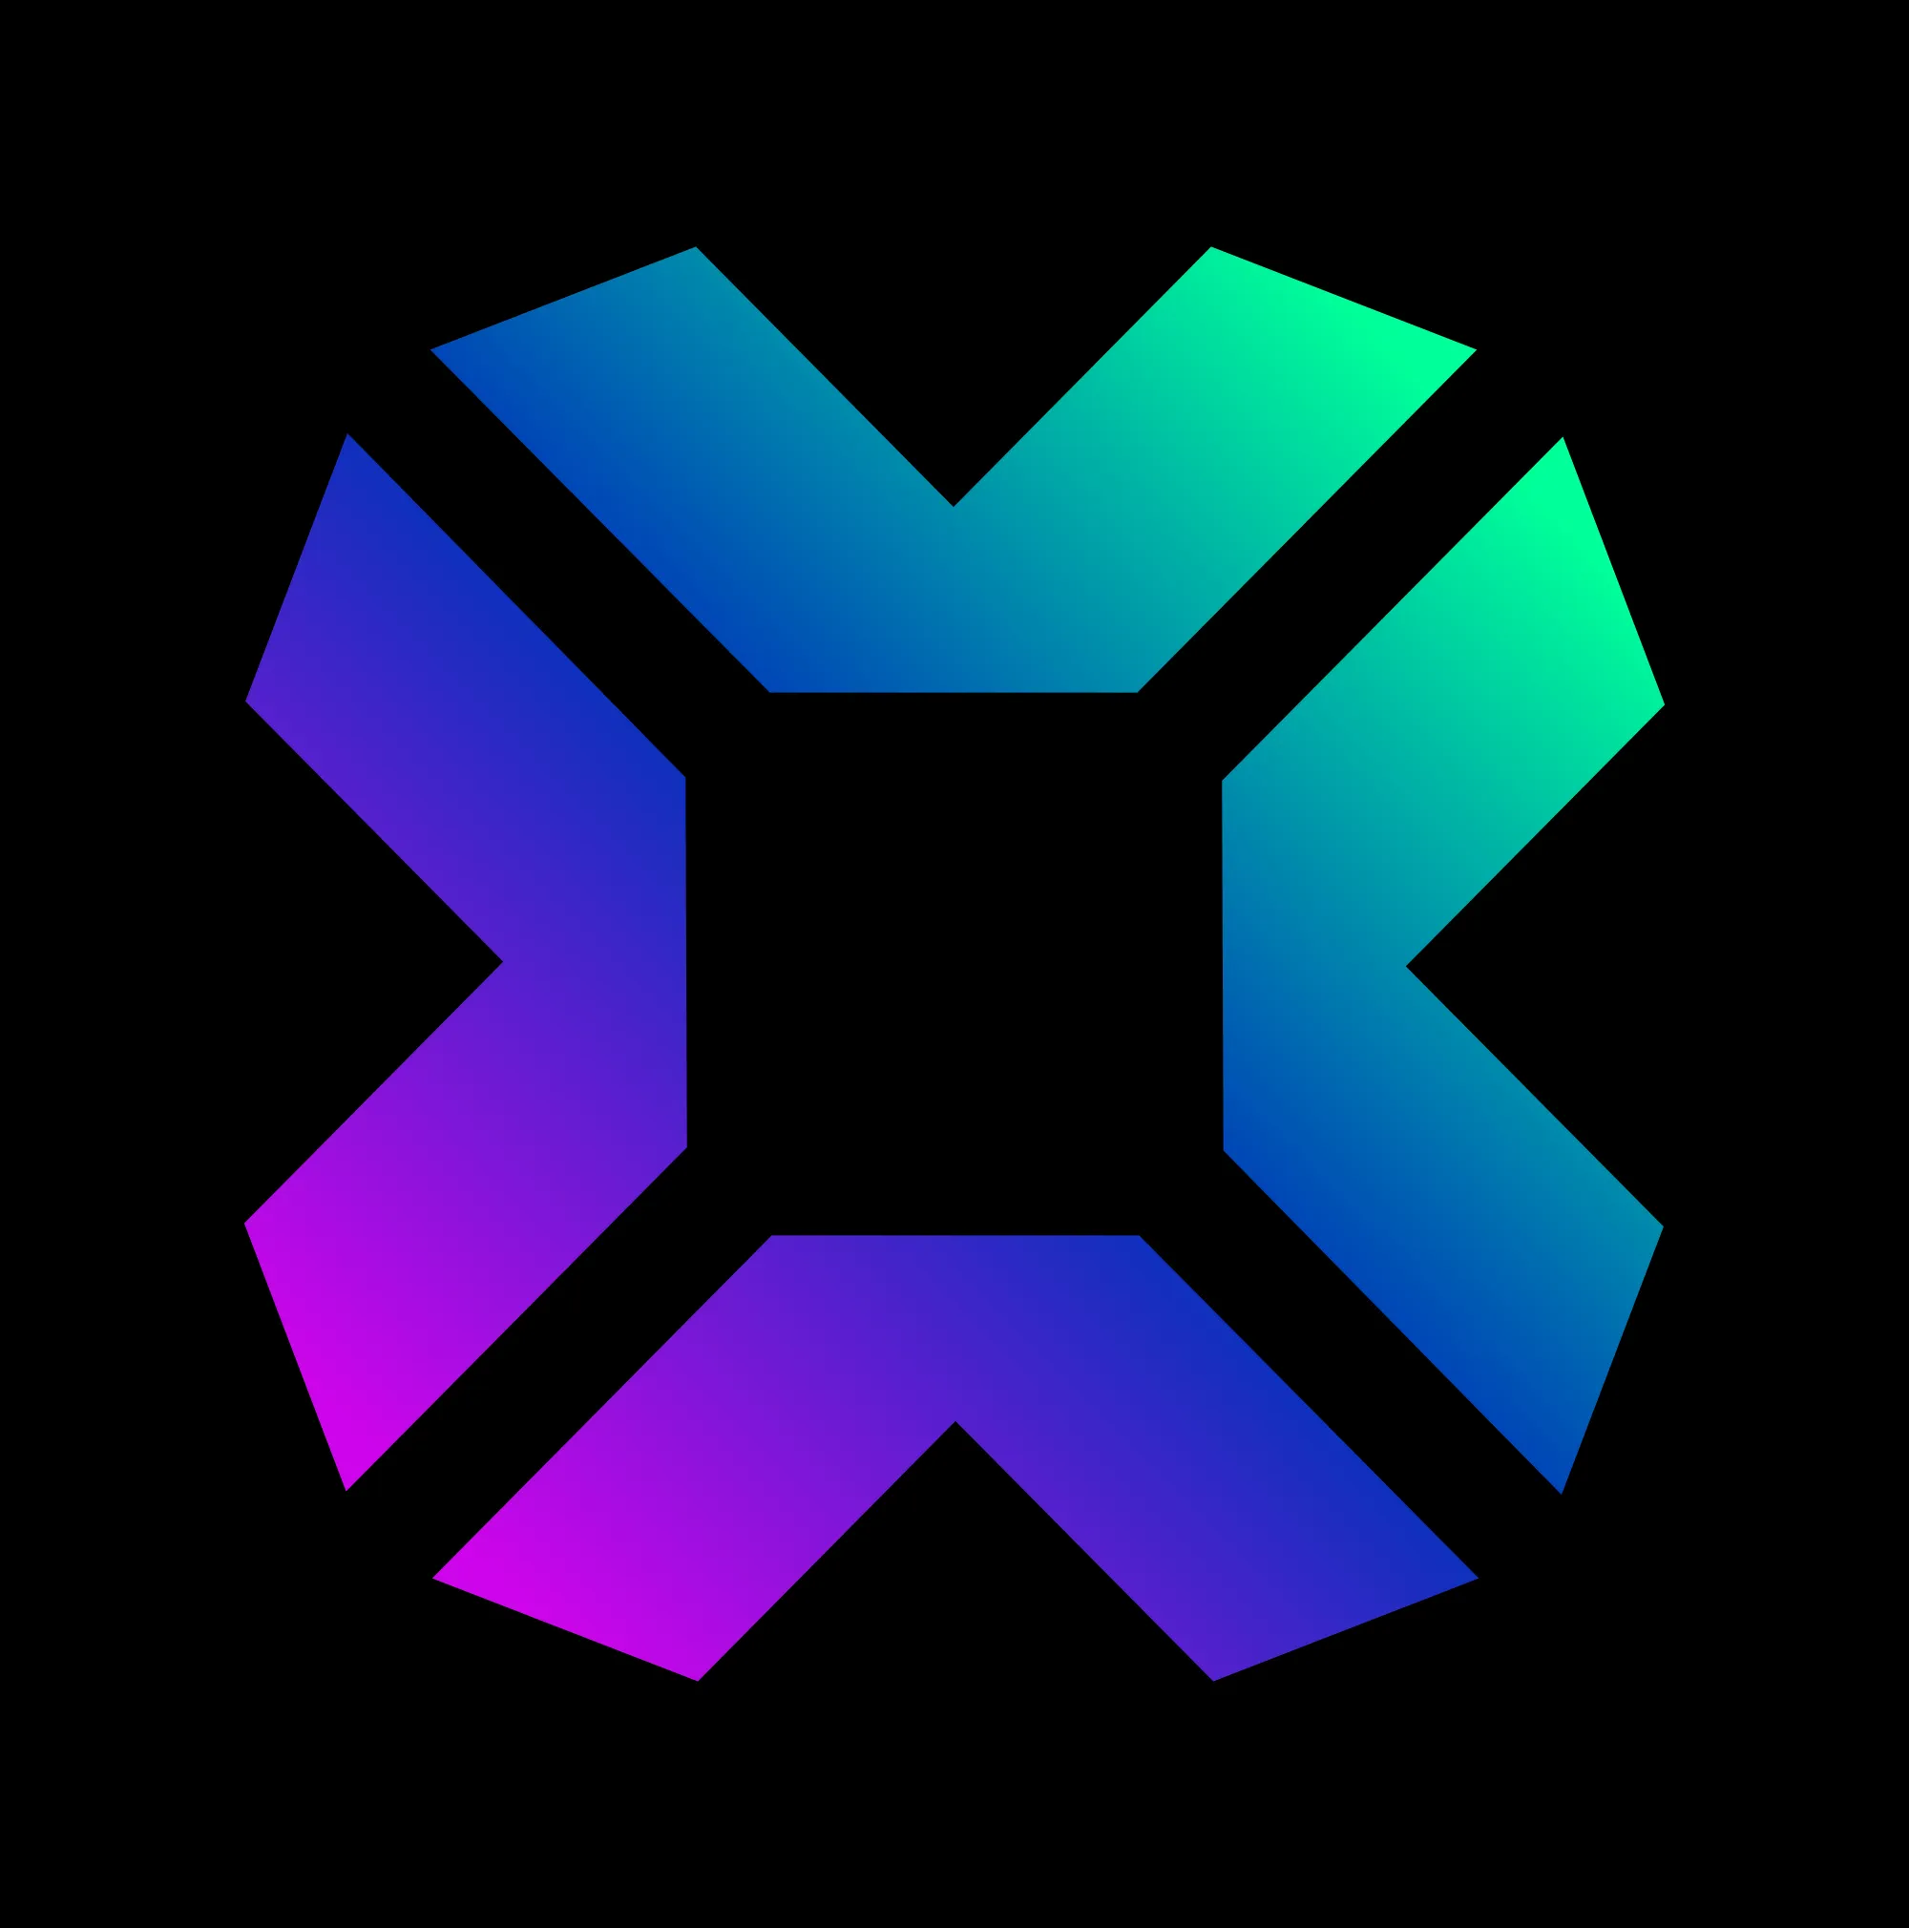
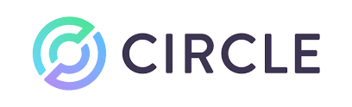


Solana as an Operating System
Applications
You build here
SDK & Library
…
Operating System

Slide 40
So, you want to build?
Ask yourself if you are building an Operating System, a Library or an App
then learn your stack

Slide 41
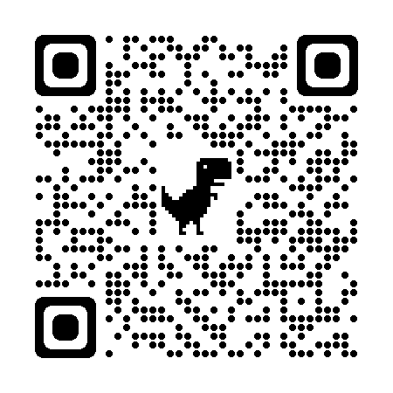
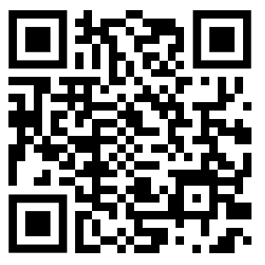
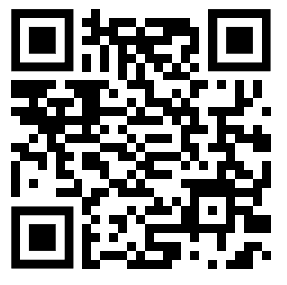
It is “Crypto Twitter (X)” !
Superteam
Solana Twitter List
Ogs in Building

Slide 42
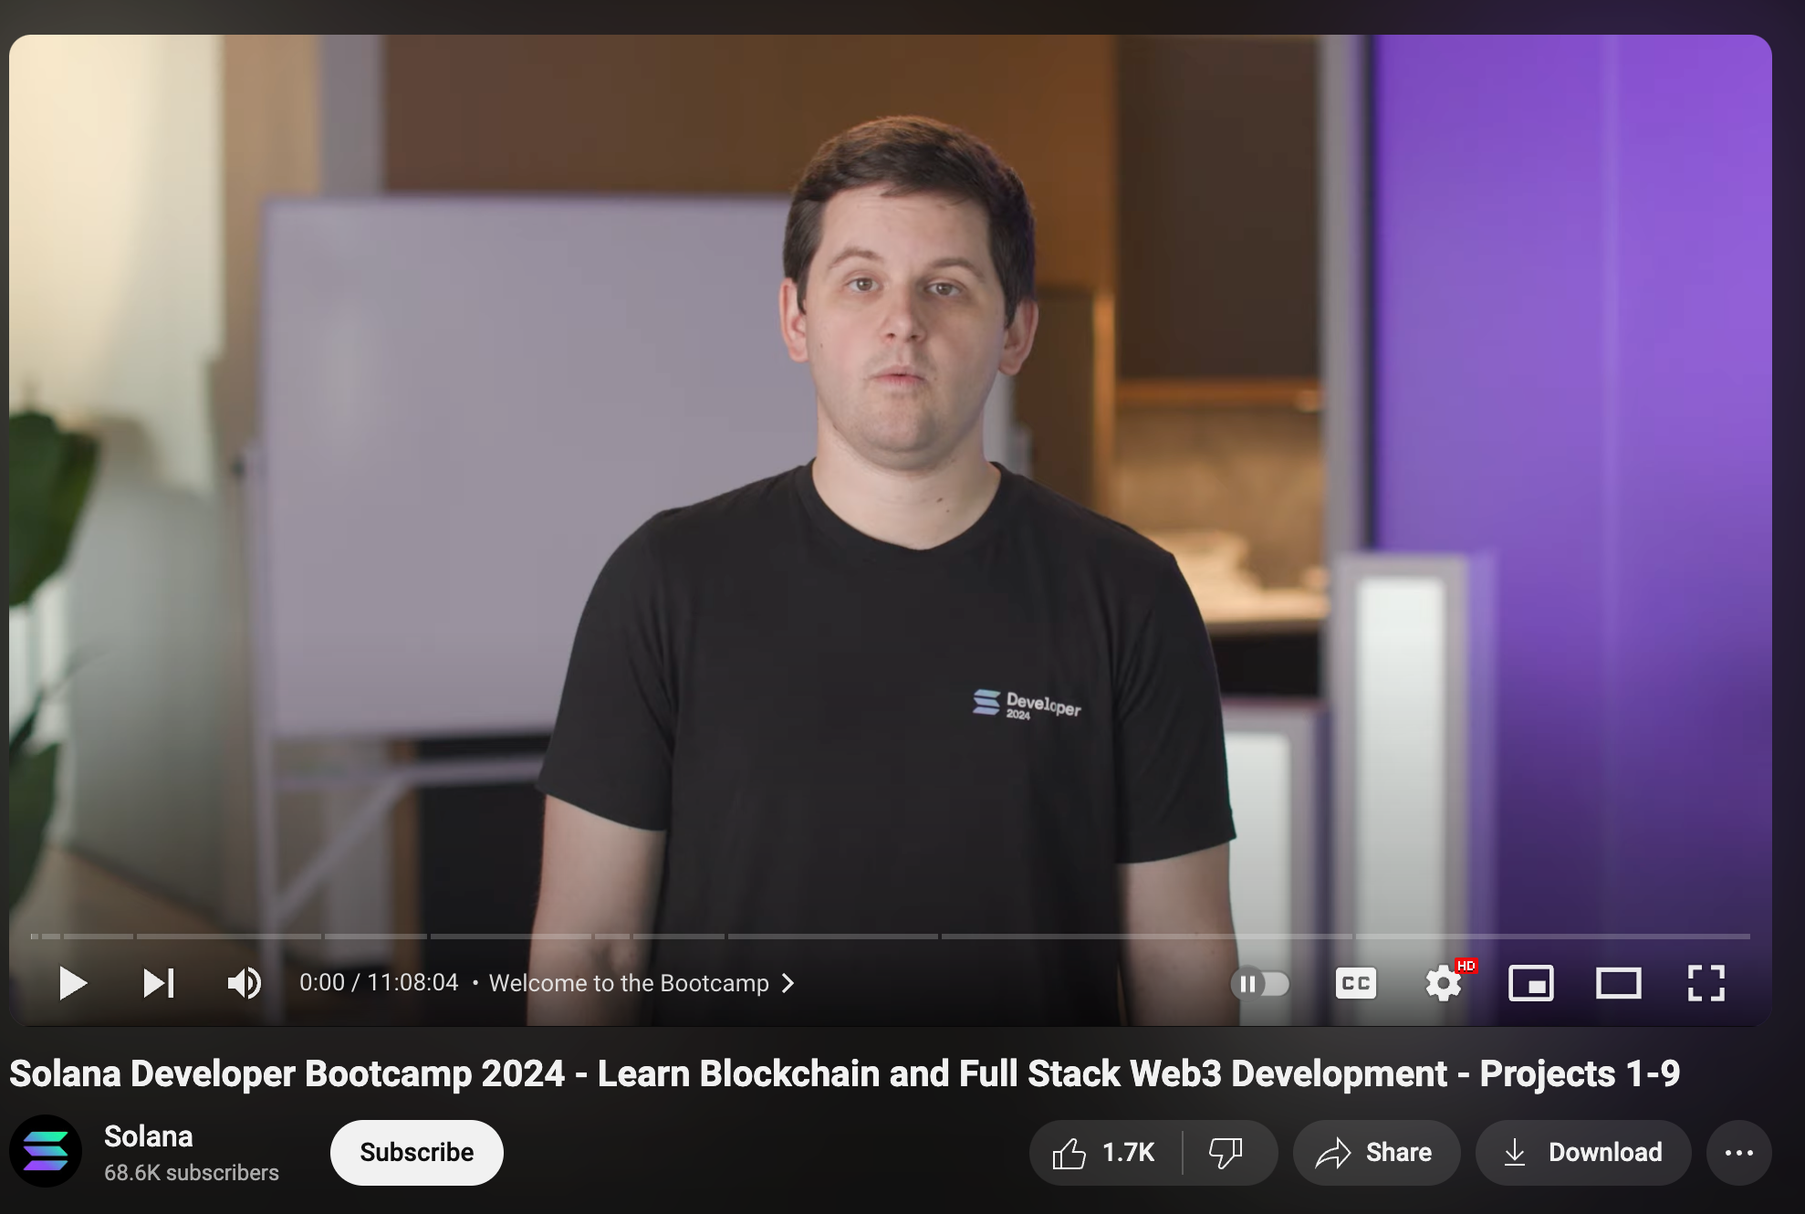
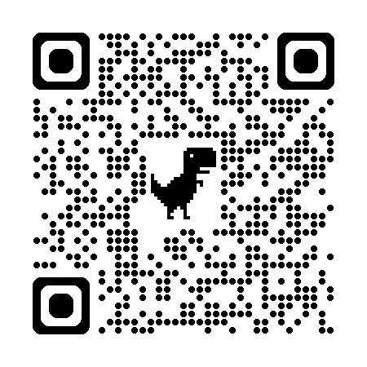
Commit to learn
Solana Bootcamp

Slide 43
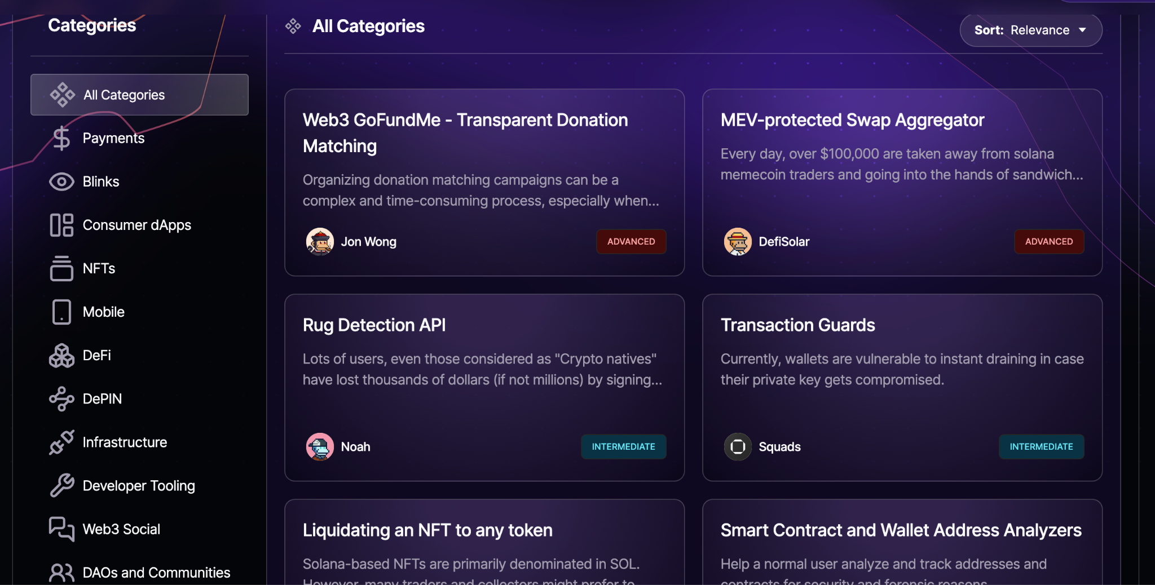
The idea list coming from distribution channel
https://build.superteam.fun/

Slide 44
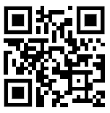
Practise
Download Solflare
Create new account
Tweet: “Today, I get started with #solana through @SuperteamUK [wallet address]”
I will airdrop to 10 first tweets

Slide 45
Q&A
Airdrop time !

Slide 46
Economical incentive to run a node validator
Network Token as “gas fee”
BitCoin - BTC, Ethereum - ETH, Solana - SOL
Fiat as “gas fee”
ICP - Fiat (IMF’s Special Drawing Right, a basket of fiat)

Slide 47
Consensus mechanism
Each blockchain design their own consensus mechanism E.g: Avalance Snowflake, Cosmos, Bitcoin’s Proof of Work, Proof of Stake, etc.
What is network finality (aka: consensus finality)
Bitcoin, Etherem, Solana, …: it is non-deterministic, but after few minutes to seconds, it is superhard to revert the network state
Với Cosmos, SUI, Aptos, …: Deterministic after a block is produced

Slide 49
A brief history on Blockchain

Slide 50
Timeline
BitCoin (2009)
Cross border payment
It is not design for other job (than payment)!
Ethereum (2015)
1st Decentralized Operating System
Sequential super computer
Found product market fit in Finance

Slide 51
Timeline (cont.)
Solana (2020)
Parallel supercomputer
Great for consumer app
Cosmos SDK (2018)
Getting popular after 2020-2021
This NOT A BLOCKCHAIN NETWORK, this is an open-source. Use it to build your own blockchain network

Slide 53
Solana Development
@0xk2_
#Javascript #Rust #Anchor

Slide 54
How to learn Blockchain Development?
Official document
https://docs.solana.com/
https://www.anchor-lang.com/
Courses:
https://buildspace.so/builds/solana-web3-app
https://buildspace.so/p/solana-core
https://www.soldev.app/course
Twitter Crypto
https://twitter.com/i/lists/1520699027314343936

Slide 55
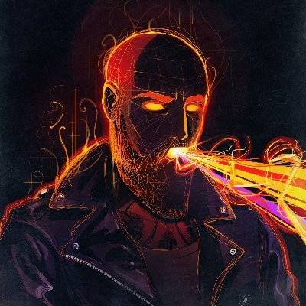


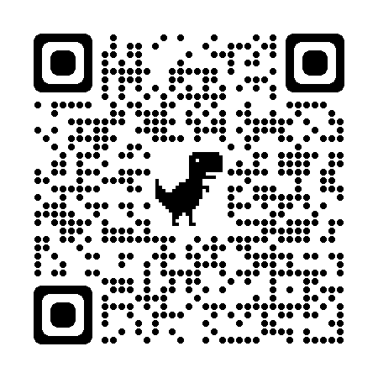
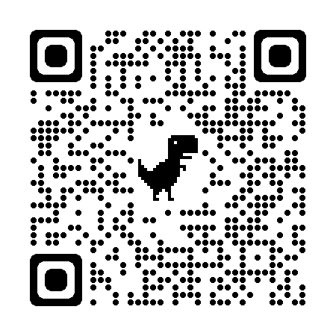
Solana sensei
https://github.com/helius-labs/solana-awesome?tab=readme-ov-file
Helius-lab Solana awesome
Solandy Youtube
0xMert_
codinpsycho
HeyAndyS

Slide 56
Refresh:
How Blockchain works?

Slide 57
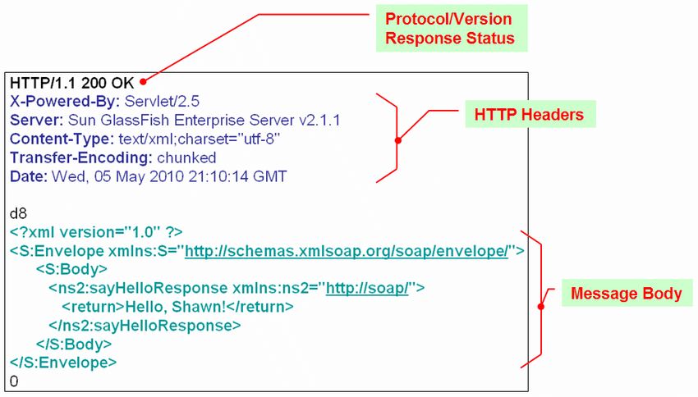
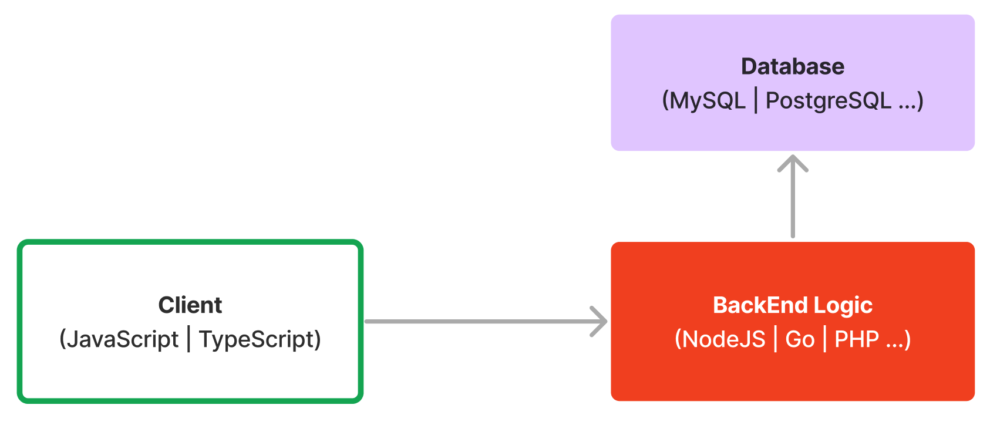
Web development
A HTTP request

Slide 58
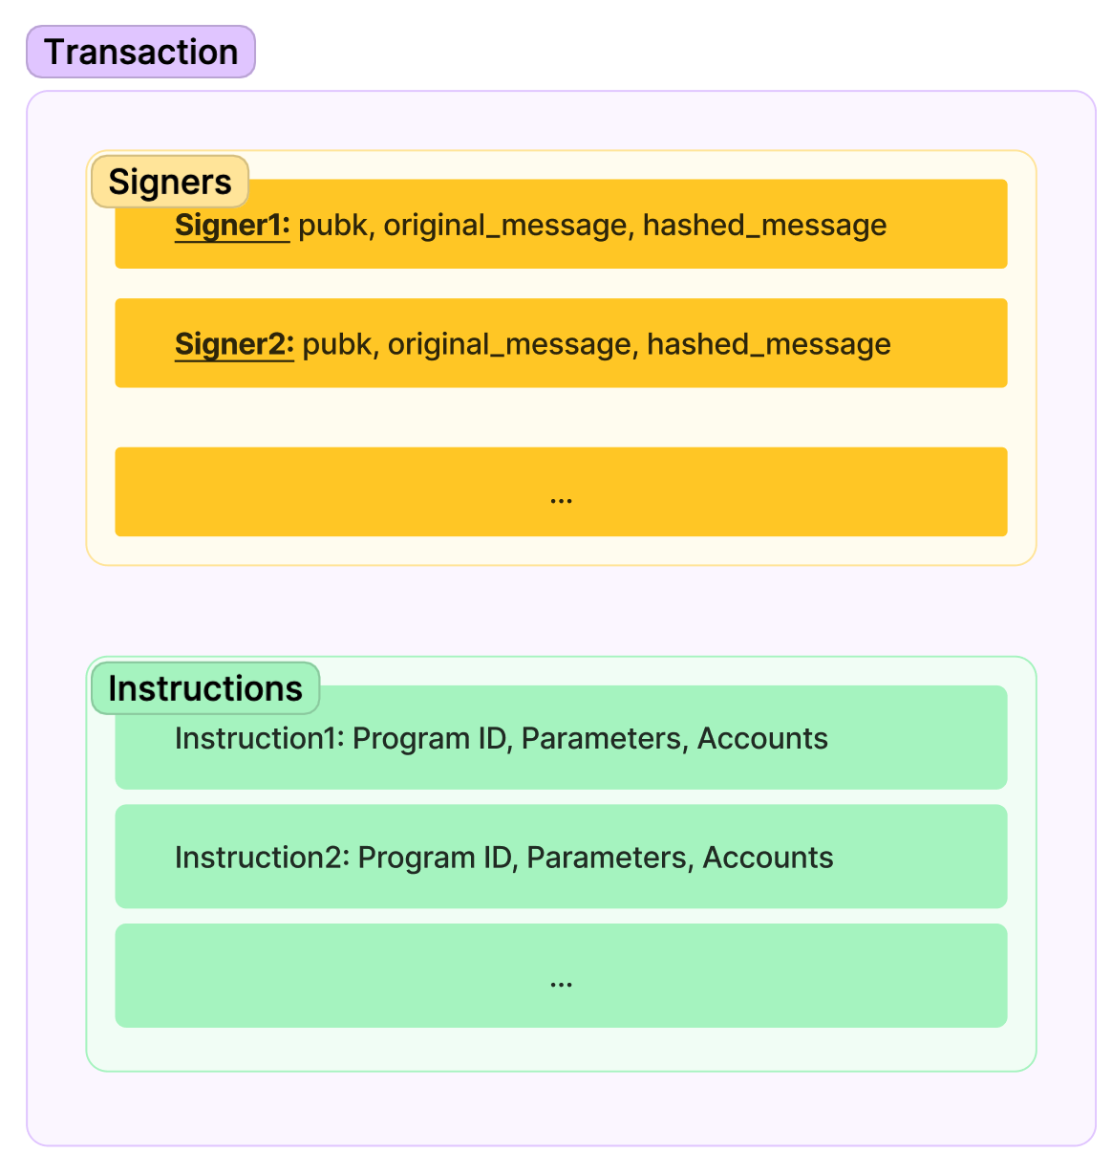
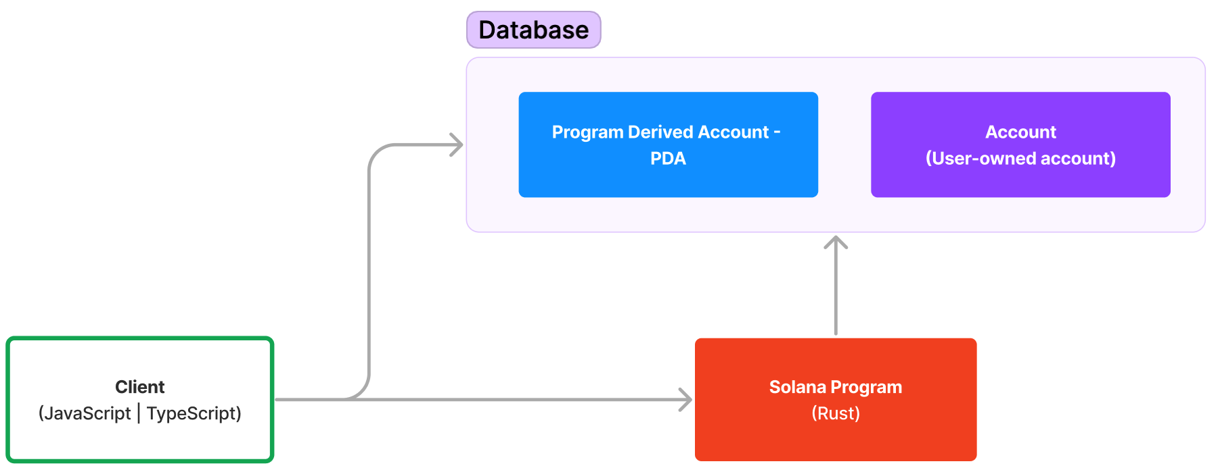
Web Development <> Solana Development
A Blockchain Request

Slide 59
Let’s read some on-chain data
Repo: https://github.com/0xk2/solana-intro-client

Slide 60
Everything is just a FILE

Slide 61
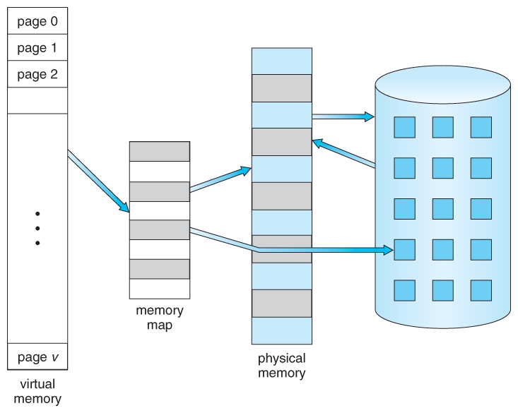
Computer Memory Management
Address | Value
1 | 71
2 | 8
3 | 12
4 | 68

Slide 62
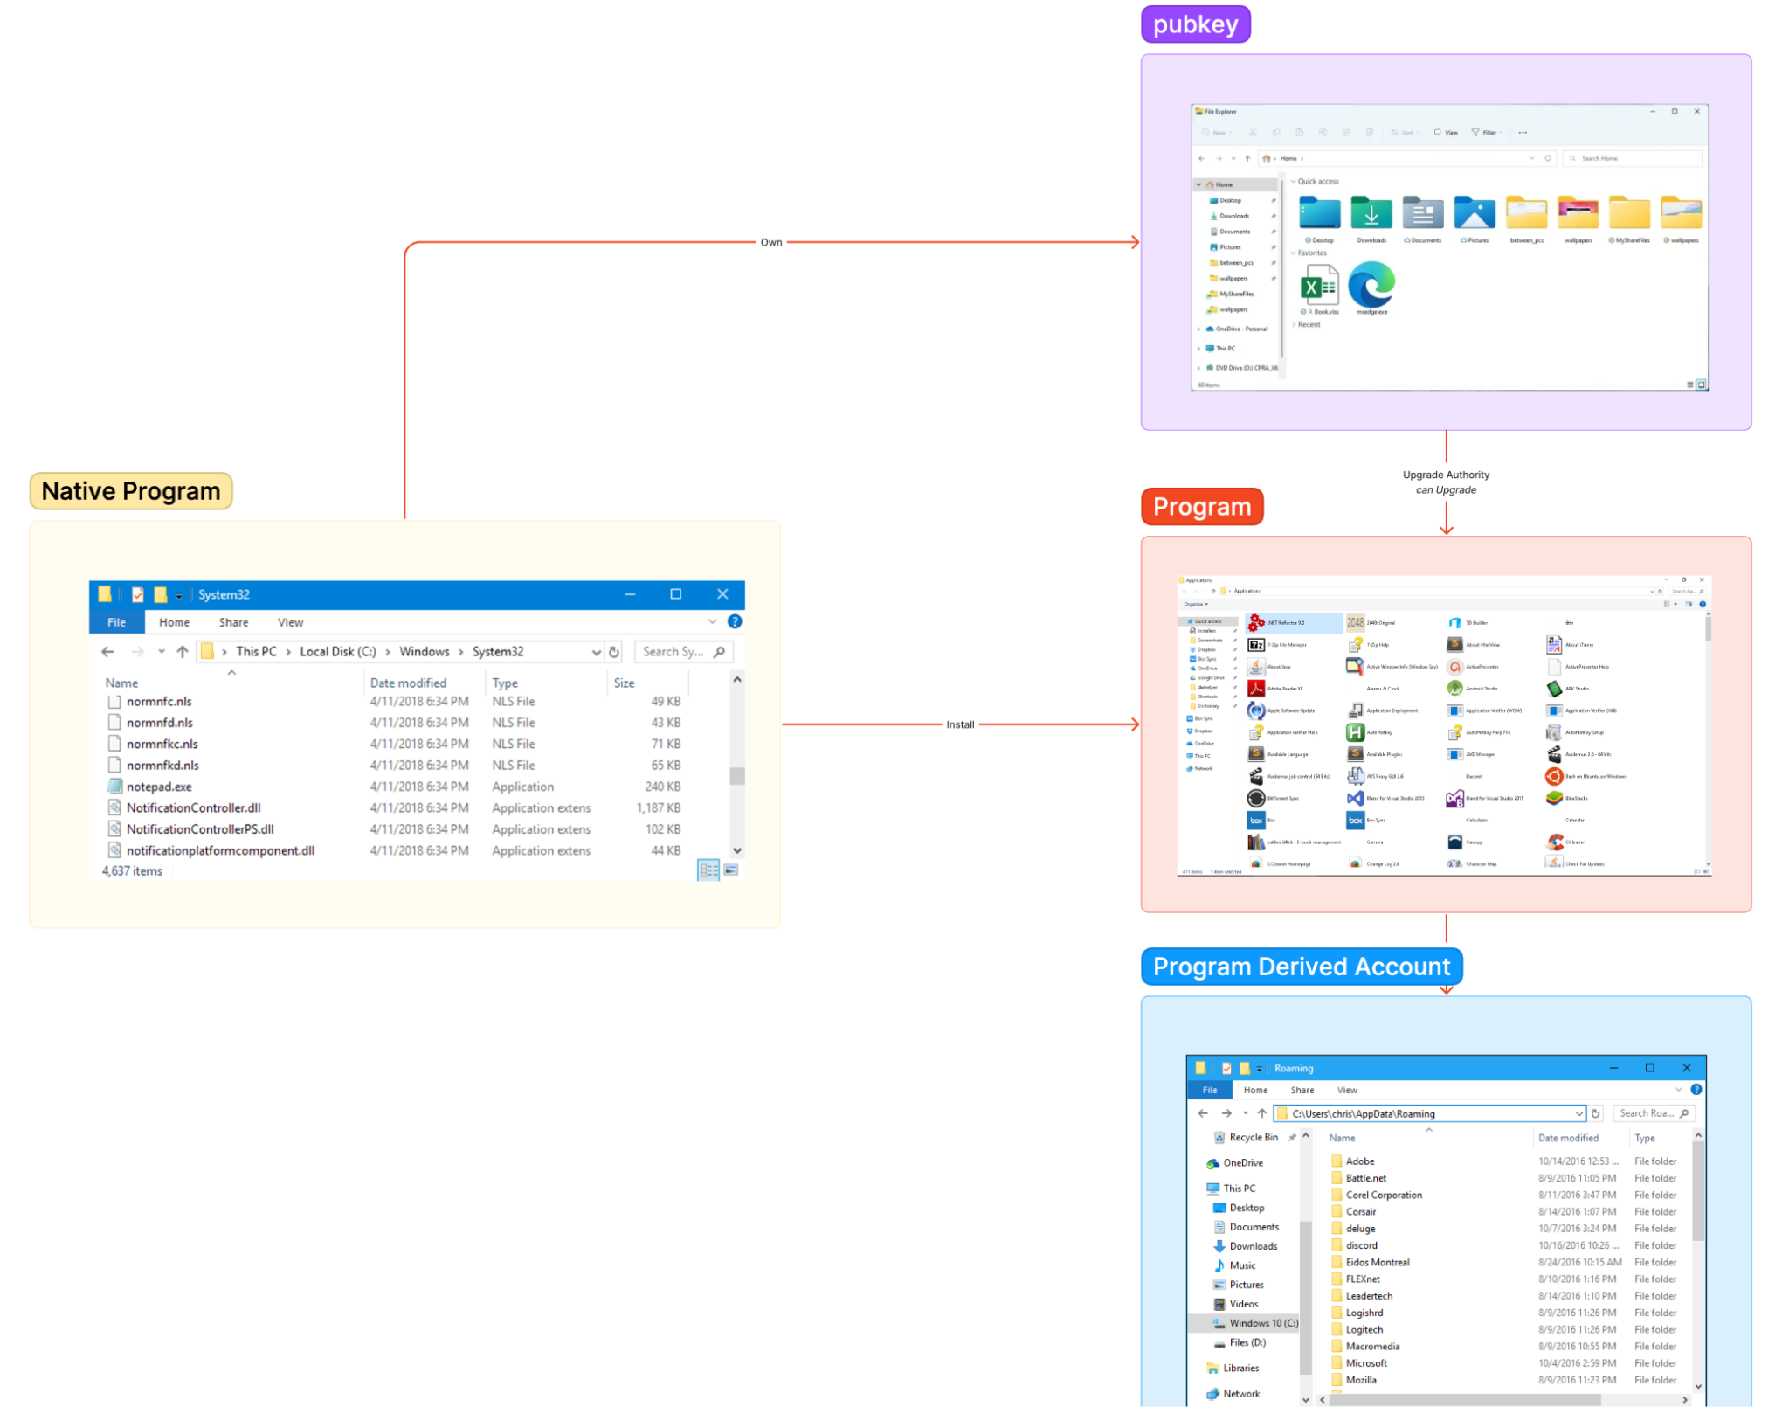
Windows “File” Model

Slide 63
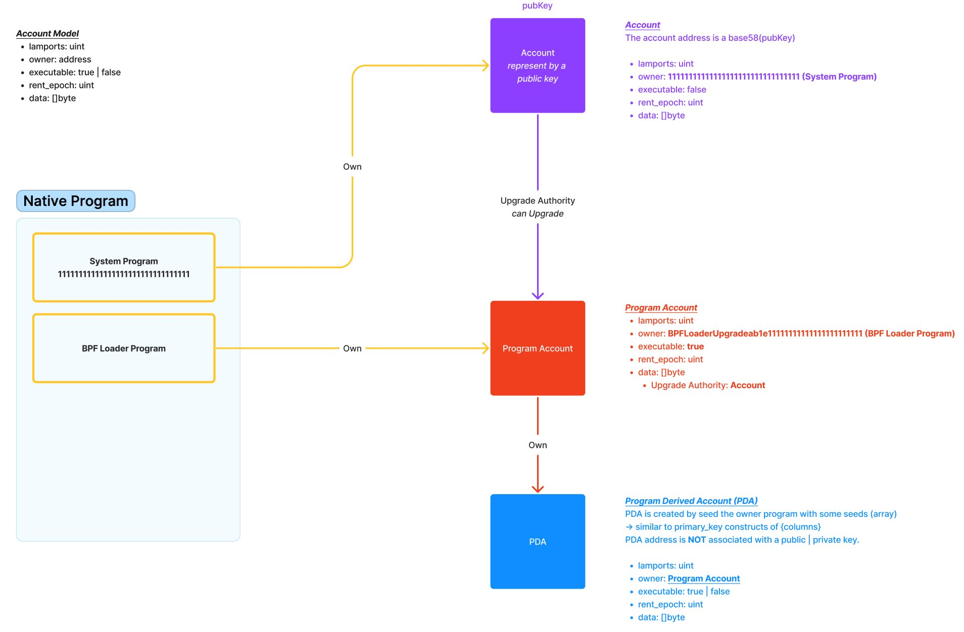
Solana “File” Model
Note:
Account data is always empty
There is no private key can claim ownership of a PDA

Slide 64
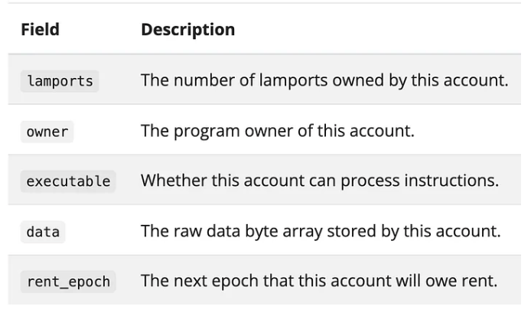
Few important concepts
Everything in Solana is an account or a FILE
A Program is an executable File.
A program is immutable between transactions
However, a program is updatable
Technicall, a Solana Program is a Library
Ownership
System Program owns Account
Programs own PDA (Program Derived Address) accounts
1 SOL = 10ˆ9 lamport

Slide 65
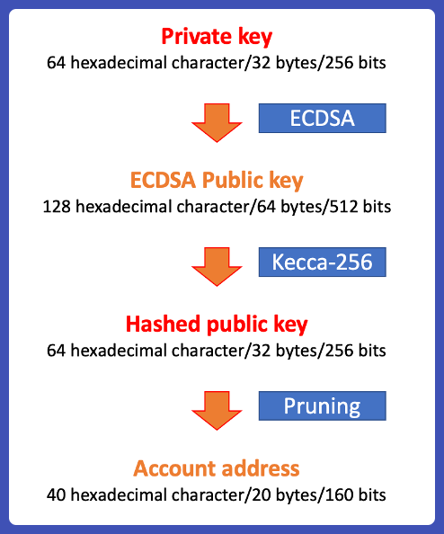
I have a Private Key …
Each Private Key can only generate ONE ADDRESS
Of which represent the Account (file) that the Private Key owns
This account is not existed till someone send some $SOL the address so the FILE can be created
The “data” of this file is ALWAYS empty

Slide 66
Programming in Solana
Code
Anchor (Rust)
Seahorse (Python)
Solang (Solidity)
Compile
Rust
Deploy
Solana Network

Slide 67
How Solana Virtual Machine work

Slide 68
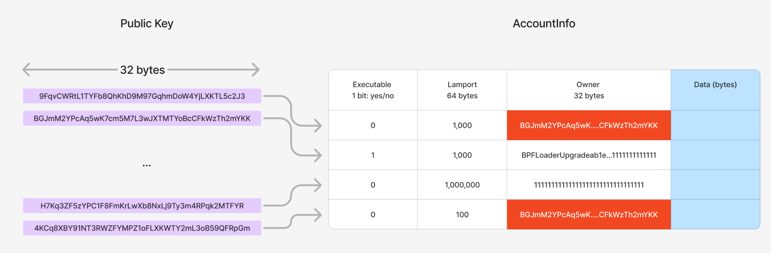
How Solana memory looks like

Slide 69
How ownership looks like
Only owner can change the ‘data’
As owner is always a program, then the `ownership` is programmable
If the owner is ‘111…111’, then whoever has the private key ‘own’ the data
* You do not directly own the data, you own it through the logic of a Program.

Slide 70
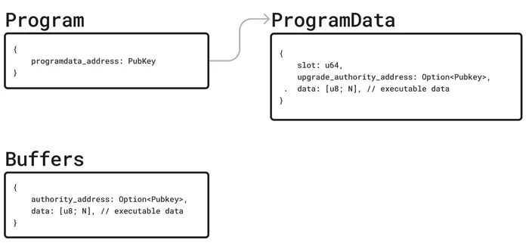
How deployment looks like

Slide 71
Mini hack time!
Airdrop time !

Slide 72


Build a wall of wish

Slide 73
Design the data structure
[“wall”]
{ title: String,
total: u8
}
Wall
Program
[“wish”, pubKey]
Wish
{ content: String
}

Slide 74
Design the function
Program
Wall
init
User
carve
Wish
“some_wish”

Slide 75

Let’s see some code
https://beta.solpg.io/65f04d0ecffcf4b13384cf9c

Slide 76


Coding Challenge
1/ Write the “carve” function
2/ Go to here and submit your project link

Slide 77
Home Work
Install Solana & local development
Install Anchor
Now, you have only 1 wall, can you build multiple wall? Elaborate on that!

Slide 78
Q & A

Slide 79
Mock problems to solve after this
Attention bidding to solve university submission peak time
Problem: At the end of semester, prof receive many submission within a short time and have to provide feedback to all of them. It seems “fair” to provide good feedback to everyone, but it is not possible. Should find a way to prioritize what submission receive more attention and what not.
Solution: Each student receive “attention token” from school and distribute them to prof to show their weighted attention for each course. Prof use this as indicator to distribute their resource to each submission.
Task trackers: split a big task into smaller ones for community to pick

Slide 80

Token Program example
Let's take a look at how a Token program structure its files.
Whenever you create a new Token, you use the Token Program to create a Mint Account aka a File which hold some critical info of ur token. Non-critical be stored in another file ... I mean account: Metadata Account

Slide 81

Let’s practise !
https://explorer.solana.com/address/8RjWfSbXSjVtsGRWPM8YrQHaPgdkw7W64TQ7v2FxZ8Fm?cluster=devnet

Slide 82

Advance: Let’s see how Metaplex NFT store its data
https://explorer.solana.com/address/FCk24cq1pYhQo5MQYKHf5N9VnY8tdrToF7u6gvvsnGrn?cluster=mainnet

Slide 83
A final word on PDA
Like any software, a Solana Prorgram need files to store their states and Solana named them PDAs identified by seeds.
Think of Solana like a giant HARD DRIVE, each program is a has a folder and seeds act like filepath within the folder to find and read/write to the file.

Slide 84
How to deploy Code with Solana
Solana Validator
Solana Client
Solana Validator
upload
Binary File
Solana Validator
Compile
Rust Code

Slide 85

Solpg <Solana Playground>

Slide 86
Coding Session #1 (15 mins)
Getting Started with Rust
https://doc.rust-lang.org/book/title-page.html
What to do?
Install RustC
Install Cargo
"Hello World" program

Slide 87
Install Local Dev Environment
Solana Client
Cli suite: https://docs.solana.com/cli/install-solana-cli-tools
Build from source: https://github.com/agjell/sol-tutorials/blob/master/building-solana-from-source.md
Anchor - Rust boilerplate
https://lorisleiva.com/create-a-solana-dapp-from-scratch/getting-started-with-solana-and-anchor
Seahorse - Solana with Python

Slide 88

Solana Development

Slide 90
What Makes Solana Special?
Technical Innovations
Notes:
Solana is a decentralised blockchain built to enable scalable, user-friendly digital products for the world.
This is the infrastructure to fundamentally change the digital world into a user-owned and operated platform. Meaningful adoption can only come by creating real utility for real people.
Solana is very much ready for it and has some unique use cases and experiments that are not possible anywhere else.

Slide 91

8 Innovations that Make Solana the First Web-Scale Blockchain
Written by Toly, founder @ Solana
But, today I am not talking about that
Where I stand ~ exited 2 web2 startups with few mils users
Skeptical engineer, want to understand trade-off, never buy in “moon”
Pragmatism founder, want to build something useful
Programming is easy, building business is NOT

Slide 92
What trade-off Solana is making?
Rust is damn hard, I have to pay attention to every memory address I am gonna read or write
Enable parallel computing without a super complex VM & make transaction computationally efficient (low cost).
Dev can eat glass usually build high quality products
Not a very decentralized network from day 1, but design to get there with mass adoption
Computing & Networking is generally cheaper over time.
We are starting from AWS - Google Cloud - M$ Azure - Alibaba cloud toward a more decentralized future. NOT from Ethereum or Bitcoin state. P/S: the hosting service is decentralized in its nature.

Slide 93

Build and use by engineer, not academia
Multiple signature transaction, a lot of good UX practise without additional infrastructure:
Gas-less transaction
Multisig
Besides Ed2551, support Secp256k1 for UX
EVM user can hold data in Solana ~ 90% of crypto users?
… what about Secp256r1 to support all iOS & android device? Read more here

Slide 94
No monopoly (moat), no money
Bad monopoly:
Data moat: Fragmented & data silos, prohibit innovations
Branding moat: A losing game for both Capitalists and Consumers via Vampire attack (web3 just make it quicker)
Uber <> Lyft
OpenSea <> Blur, Uniswap <> Sushiswap
Why blockchain business is so hard? There is very hard to build moat.

Slide 95
Good data abstraction earn you great money
Welcome the new monopoly: the Standard tyranny
Enable by:
Logic <> Data separation
Solana Data ownership model
PDA is own and mutable through the Program
Each Program owns it Data Abstraction, thus can monetize this moat

Slide 96


The GOAT: MetaPlex

Slide 97
Am I dogfooding?
Yes, with @syncvote, it is #OPOS (Only Possible On Solana)
I am building:
New standard for keeping workflow design on-chain (pay me a few lamports when you start a new one)
Crypto-agnostic software: gas-less transaction, private key as a service
Blockchain not for function but for scale
My ultimate customers: all governments on earth

Slide 98


One more thing
Token2022, the new kid in town:
Custom transfer fee, hook or no transfer at all
Interest bearing token
Confidential Transfer, in short: on-chain cash & central bank
Homomorphic encryption
For nerds
Degen

Slide 100
Building blocks of DeFi
Trading
On-Ramp Fiat to Crypto, tool: Binance, Remitano, p2p trading,,.
Off-Ramp Crypto to Fiat, tool: Binance, Remitano, p2p trading,,.
Invest

Slide 101
DeFi decrypt

Slide 102
Exercise
Download Binance & Create your account
GBP -> USDT with Peer to Peer method
Trade GBP -> $SOL
Deposit $SOL into your wallet
Go to Orca, swap $SOL to $BONK

Slide 103
Decentralized Finance

Slide 104
A brief history of PRICE

Slide 105



Bargain (1)
The buyer & seller must show up at the same time to bargain.
Can function without a currency

Slide 106
Bargain (2)
Slow
Can work without a currency

Slide 107


evolve
Bargain
Order Book

Slide 109
A brief history of “Price”
 | Size | Transaction speed | Price certainty
Bargaining | Small | Super slow, depend on both parties | Volatile, based on trading parties
Order book (aka Manual Market Maker) | Territory | Only operate in Market time & Take a few day for a transaction to be cleared | Stable, on the mercy of gatekeeper
Automated Market Maker (enabled by crypto, comeback later) | Internet-size | Network speed | Depend on the Liquidity Pool & Price algo

Slide 110

How AMM works?
K=X*Y
K is a constant
X is the number of token A in the pool
Y is the number of token B in the pool
Demo on web
Let's build on Excel!

Slide 111
DeFi summer <2019>
The birth of Uniswap (the first AMM) created the revolution on Price and Liquidity and start the Decentralized Finance industry.

Slide 112
Who Finance benefit and How ?

Slide 113
Finance benefit societies by distribute Capital to whoever build what human need
Finance provide business owner Capital, which he will provide society with:
Goods (physical & digital)
Services
In return, investors receive more Capital

Slide 114
What DeFi is trying to solve?

Slide 115
Country border prohibits Money flow.
Ownership is enforced by LAW
Law is only enforced within sovereignties.
Border prohibit the free flow of Money aka Capital.
Traditional finance is optimized toward social stability
Licenses & barrier to join the industries
Laws to protect investors from self-harm activities

Slide 116
Internet delete BORDER of Knowledge
DeFi delete BORDER of Capital

Slide 117

DeFi Structure
Fiat-pegged Stable Token enable Fiat to flow into blockchain, it works (theoretically) like this:
Each token is minted if there is 1 USD backed it up in the bank
If there is one USD withdrawn from the Bank then a token must be burnt
Native coin is the primitive way to turn Computing Power into money
Exchanges do not affect the total amount of Capital within Blockchain.

Slide 118
Trading Platform (CEX/DEX) is the centerpiece of the ecosystem

Slide 119


Slide 120
Investment is where DeFi create VALUE

Slide 121


Slide 122
Q & A

Slide 123
Further reading
https://www.coinbase.com/learn/crypto-basics/what-is-defi
https://twitter.com/BanklessHQ
https://twitter.com/thedefiedge

Slide 125
How public Blockchain revolutionize the approach to organizational development
Trung Hieu Bui
trunghieubui88@gmail.com

Slide 126
Agenda
An Application of Public Blockchains on organizational development: Decentralised Autonomous Organisation
DAO is the evolution of human organisational tools in Digital Age
Major challenges for adoption
Conclusion
Note: Read the paper in full here

Slide 127


Hobbes’s Leviathan in the Digital Age

Slide 128

Public Blockchain and organizational development
Public Blockchain
A cloud computing design that digitalise and automate TRUST
Features: Permissionless, Transparency and Censorship resistance
Decentralised Autonomous Organisation
Application of Blockchain technology (smart contact) in building (digital native) organisations
Alternative (Direct Democracy, Futarchy) and improvement to Delegate Democracy
Node
Node
Client
Client
Blockchain Network
Notes:
Fully transparent rules, proposals, and token-based voting process

Slide 129
Discover and enforce crowd sentiment through Blockchain Technology
The DAO Model
Phase 1: Build the Treasury
Treasury
Phase 2: Discover the Crowd’s Preference and Enforce it
Community and Team
Voting System

Slide 130


DAO is the evolution of human organisational tools in Digital Age
Efficiency in collecting crowd’s sentiment is disrupting Representative Democracy Voting
Liquid Democracy
Quadratic voting (Lalley & Weyl 2015)
En-masse Direct Democracy is becoming practical
Issues-based voting instead of Representative Democracy
Digital Native Nations
Liquid Democracy

Slide 131

Digital nation is here, what is your choice? autocracy or democracy?
DAO is the Digital-Native Democracy
Voluntary members lead to better cooperation
Lower cost to join & leave than traditional organisations
Can participate in multiple organisations at once
Blockchain unlocks transparency over voting, and enforcement
Digital native bureaucracy deliver high performance with low cost
Transparency provide better holacracy & merit-based system
New mechanism to distribute wealth that better achieve social justice
Autocratic Digital Nations

Slide 132
What are the main challenges for DAOs?
Disconnect to the Real World limited Treasury building & Enforcing community’s will
DAO Treasury can hold very few type of assets
Smart-Contract IoT integration is scare
Lack of both technology and best practises for DAO operators

Slide 133

Disconnect to the Real World limited Treasury building & Enforcing community’s will
Smart-Contract is not widely recognized by Governments, legal framework to operate is unclear
Accessibility
Enforceability
Sovereignties to incorporate a DAO in 2023

Slide 134

DAO Treasury can hold very few type of assets
Most Treasury can only hold crypto token & NFT
Limit ability to fund raising
Limit ability to attract more people
MakerDAO is one of the first to experiment with RWA in its Treasury

Slide 135

Smart-Contract IoT integration is scare
The enforcing power of DAO’s decision is limited
“Can a DAO’s decision change a machine’s state for good?”
Helium IoT network

Slide 136
Lack of both technology and best practises for DAO operators
High transaction fee encourage DAO member to “signal” through off-chain voting instead of on-chain voting. E.g: Snapshot vs Tally
DAO tools are primitive, lack of best practises and templates for DAO operators to follow. Hence, “Too much power given to unprepared normies” to facilitate large group collaboration
Organization structure
Voting mechanism
Incentive structure

Slide 137
What DAO can solve versus not?
Now, DAO is ONLY useful where no Real World Assets involved or Internet of Thing integration is high, esp. when “code is the only law”
If CODE enforceability is low then DAO is still vital in fields whereas blockchain’s immutable nature is valuable
DAO is not helpful whereas “code is law” is not desired or limited

Slide 138
Now, DAO is ONLY useful where no RWA involved or IoT integration is high, esp. when “code is the only law”
DAO is useful when its on-chain decision is enforceable:
Pure digital service, e.g: digital content, crypto crowdsourcing investment, finance service, etc.
Highly digitalized logistics system, e.g: smart city,

Slide 139


If enforceability is low then DAO is still vital in fields whereas blockchain’s immutable nature is valuable
Certification & digital verification, e.g: carbon market, notarize, digital identity for both human and object, asset management, etc.
Reputation-related: bureaucracy, public opinion aggregation
6DyHVbVPstZeJF1gxxADb55FApENyPFHPrwrHjWpSKS2
Syncvote.com: a tool to design and run a workflow on-chain

Slide 140

DAO is not helpful whereas “code is law” is not desired or limited
Same-sovereignty parties within high authoritative nature
The smaller the number of parties, the less DAO is needed e.g: UN Security Council
Whereas enforcing decision is not implemented or prioritized e.g: UN General Assembly

Slide 141
Conclusion
DAO model
DAO is an organizational evolution in the Digital Age.
Despite its efficiency, it is facing short term challenges from lack of digitalised real world assets.
DAO adoption might immensely boost the productivity of existing organisations, given birth to new ones. Thus, potentially drag us out of economic depression.
Phase 1: Build the Treasury
Treasury
Phase 2: Discover the Crowd’s Preference and Enforce it
Community and Team
Voting System

Slide 142
References
Kleros, F. A., Founder &. CEO at, & Assas, B. D., Professor at Université Paris 2. Panthéon. (2021). When Online Dispute Resolution Meets Blockchain: The Birth of Decentralized Justice. Stanford Journal of Blockchain Law & Policy. https://stanford-jblp.pubpub.org/pub/birth-of-decentralized-justice
Posner, E. A., & Weyl, E. Glen. (2015). Voting squared: quadratic voting in democratic politics. Vanderbilt Law Review, 68(2), 441-500.
Ramos, J. (2015). Liquid democracy and the futures of governance. The future internet: Alternative visions, 173-191.
Kesonpat, N. (2021). Organization Legos: The State of DAO Tooling. Medium. https://medium.com/1kxnetwork/organization-legos-the-state-of-dao-tooling-866b6879e93e Axia8 Ventures (2023), RWA — Is it Defi’s Next Growth Engine?. Medium. https://medium.com/@Axia8Ventures/rwa-is-it-defis-next-growth-engine-2fc00f9514fb Remote Wireless Infrastructure - Helium Hotspots and IoT Devices
https://www.rfwel.com/us/index.php/helium-hotspots-and-iot-devices

Slide 143
Appendix

Slide 144

DAO Misconceptions
“There are no leaders”
Protocols are complex. Crafting successful proposals and getting buy-in from voters requires experience and familiarity.
DAOs fund full-time members and teams
“Fully autonomous”
If only software, it’s possible, but many proposals require human effort with subjective review
Example, marketing spend
https://medium.com/1kxnetwork/organization-legos-the-state-of-dao-tooling-866b6879e93e

Slide 145
Programmatic Voting: Quadratic Voting
Quadratic voting (Lalley & Weyl 2015)
Incorporate intensity of preference and knowledge into voting
Given a set amount of tokens to spread across options, but cost of additional votes increases n^2
1 vote = 1 token
2 votes = 4 tokens
Gitcoin Grants uses quadratic voting to fund digital public goods

Slide 146
Programmatic Voting: Liquid Democracy
Liquid Democracy allows fluid delegation of votes
Voter delegates to someone who can delegate again, but can always choose to vote as an individual on any issue
Encourages prudent delegators, reputation matters in a repeated game
In contrast to representative democracy, where your delegate makes all of the decisions for their term whether you agree with them or not
Type of vote: moral (individual) vs expertise (delegate)

Slide 147

Digital Native Nations
SuperteamDAO: a Blockchain is a nation
Thenetworkstate.com: a collection of cross-state nations with its own growth metrics (GDP, members, etc.)

Slide 148


Slide 149

Example: ConstitutionDAO
All DAOs are experiments. Some last longer than others. Many fail.
Crowd preference: win a copy of the US Constitution at auction
Build the treasury: raised $47M in 72 hours in Nov 2021
Result: Lost the auction, returned the money
Alternative example, AssangeDAO raised $56M to support WikiLeaks founder legal fees
Only possible due to blockchain enabled trust

Slide 150

Use Case: Charitable Organizations
Reduced overhead
Increased participation
Transparency over usage and effectiveness of donated funds
Breast Cancer Society among others raised hundreds of millions for cancer research but only 1-2% was used for research, the rest for expenses

Slide 152
Non-Fungible Token
<>
Fungible Token

Slide 153

Ethereum ERC721

Slide 154
Solana: MetaPlex Metadata
https://explorer.solana.com/address/FCk24cq1pYhQo5MQYKHf5N9VnY8tdrToF7u6gvvsnGrn?cluster=mainnet

Slide 155
Solana: Compressed NFT
Real data is stored on ledger data (transaction data)
Only store the root of merkle tree on-chain
Cost per transaction is ultra cheap
Comparable to sending an email
Good (long) read: What’s the actual point of cNFTs?

Slide 156
Why NFT?
New email marketing
https://drip.haus/
Community-gated token

Slide 157
Q & A

Slide 158
Further reading
https://twitter.com/punk6529

Slide 159
Appendix

Slide 160
Let’s play games!
2 groups: Validators & Clients
Validators should stay far away from each other and from clients.

Slide 161

Game 1: Change a global number
Imagine you want to change a number, write down your equation
Note: should be simple PLUS or MULTIPLY math
Game spreadsheet
+9

Slide 162


Reflection from Game 1
Clients
Who do you send your transaction to and why?
If you want you transaction go first, what do you do?
Validator
How do you sort the order of transaction coming to you?
How you and your validator peers agree on the order of all transactions?
How to make your network perfectly decentralized?
“I know everyone & everyone know me”
“Someone is more important to others”

Slide 163
Game 2: Change a set of global numbers
There are 3 numbers: A, B, C
Imagine you want number A|B|C:
The number you want to change
Your equation in simple math, PLUS or MULTIPLY
Game spreadsheet
A *2

Slide 164

Reflection from Game 2
Clients
Can you trust validators to not CHANGE your content (e.g: from A to B)? How to prevent them to do so?
How validator know “you are not a dog”
Validator
How do you sort all transactions?
How to make sure you are not “talking to a dog”?

